Slide 1
Growing Membership Together:
Membership & Engagement Check-In
Monday, July 13, 2026
12 Noon Central

Slide 2
Learning Objectives
Describe how APWA retention strategies can be replicated at the chapter level and identify specific tactics that can be adapted to improve member retention locally.
Demonstrate how to access, interpret, and apply membership reports to identify at-risk members and implement data-driven retention efforts within their chapter.
Explain the role chapters play in supporting APWA membership recruitment efforts and identify actionable ways to collaborate with APWA staff to grow membership.

Slide 3
Membership & Engagement Staff
Matt Harper
Sr. Membership Manager
mharper@apwa.org
816 595 5220
Maureen Weber
Membership Development Manger
mweber@apwa.org
816 595 5263

Slide 4
Recruitment Campaign Update
Direct Recruitment (Launched April 2026)
  Outreach to both current and prospective members.
  648 personalized emails sent.
  612 phone calls completed.
Current Outreach
  Localized, personalized messaging tailored to each community campaign.
  Launched in late June.
Next Phase
  Focus on communicating the financial value and ROI of APWA membership - Launching soon.

Slide 5
Recruitment Campaign for Chapters
How Chapters Can Support Recruitment
APWA recruitment efforts are underway—but local outreach is what turns prospects into members.
How your chapter can help:
Personally reach out to prospective members in your community.
Invite nonmembers to attend a chapter meeting or event.
Encourage current members to bring a colleague to an upcoming event.
Share chapter success stories and the value members receive locally.
Coordinate with APWA Membership staff on local recruitment opportunities.
Chapter Tip: A personal invitation from a local chapter member is often the deciding factor in someone joining APWA!

Slide 6
Recruitment Process
Re-engaging Former Members
  Utilize the Expired Member Report to identify outreach opportunities.
  Personalize communication based on previous involvement and membership history.
Recruiting New Members
  Research organizations by size (very large, large, midsize, and small).
  Tailor messaging and outreach strategies to meet the unique needs of each organization.

Slide 7
Recruitment Process for Chapters
Re-engage Former Members
Review your chapter's expired member list.
Contact former members to learn why they left and invite them back.
Highlight what's new in your chapter since they were last involved.
Recruit New Members
Identify public works agencies, consultants, and organizations in your area that are not currently engaged.
Focus outreach on agencies of all sizes.
Encourage chapter leaders to build relationships with local employers.
Chapter Tip: Develop a simple annual recruitment plan and assign chapter leaders to specific outreach efforts.

Slide 8
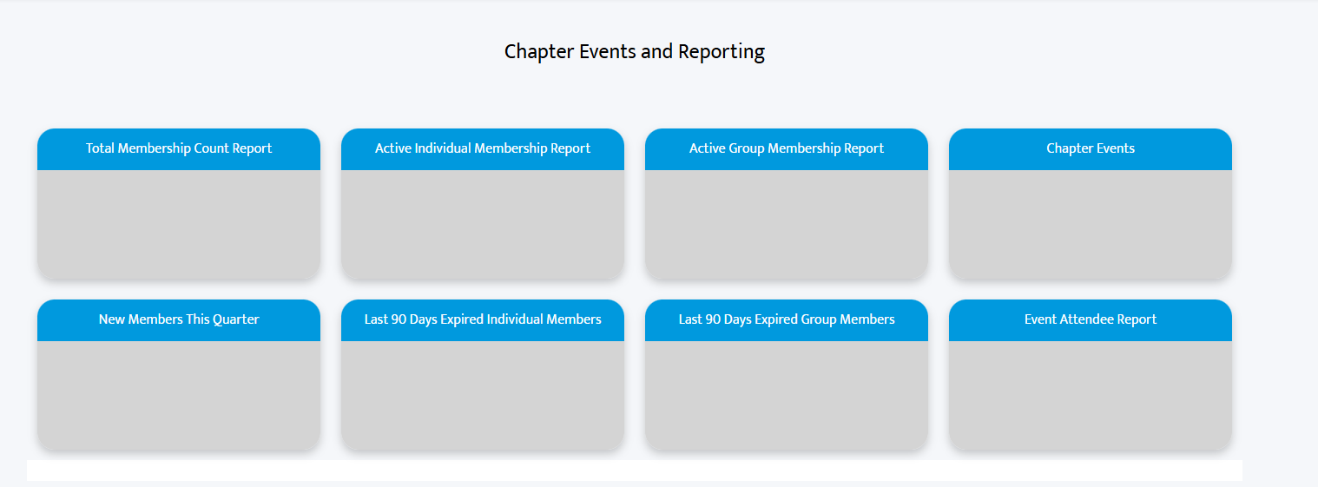
Chapter Membership Reports
Each chapter has 2 Fonteva License users that can pull reports.

Slide 9
Membership Reporting Resources
The Chapter Report User Guide walks you through the six membership reports available to chapters.
Find the guide in Chapter Leader Resources (CLR) → Membership.
Unlock more powerful reporting by using:
Sorting
Grouping
Relative Data Operators
These tools allow you to refine your data and quickly find the information that's most relevant to what you are looking for.
chapterservices@apwa.org

Slide 10
New Member Emails
Welcome: Quick Start Guide
Education and Resources
Certification and Accreditation
Member-to-Member Connection
Government Affairs
CareerZone, Awards, & More!

Slide 11
New Member Emails for Chapters
New Member Welcome Emails
Reinforce the APWA Welcome.
Every new member receives information from APWA—but your chapter can make the experience even more meaningful.
Consider:
Sending a personalized welcome email from your chapter.
Having a board member call new members.
Inviting new members to the next chapter event.
Pairing new members with a mentor or committee chair.
Recognizing new members at chapter meetings.
Chapter Tip: Members join APWA nationally, but they build lasting relationships through their local chapter.

Slide 12
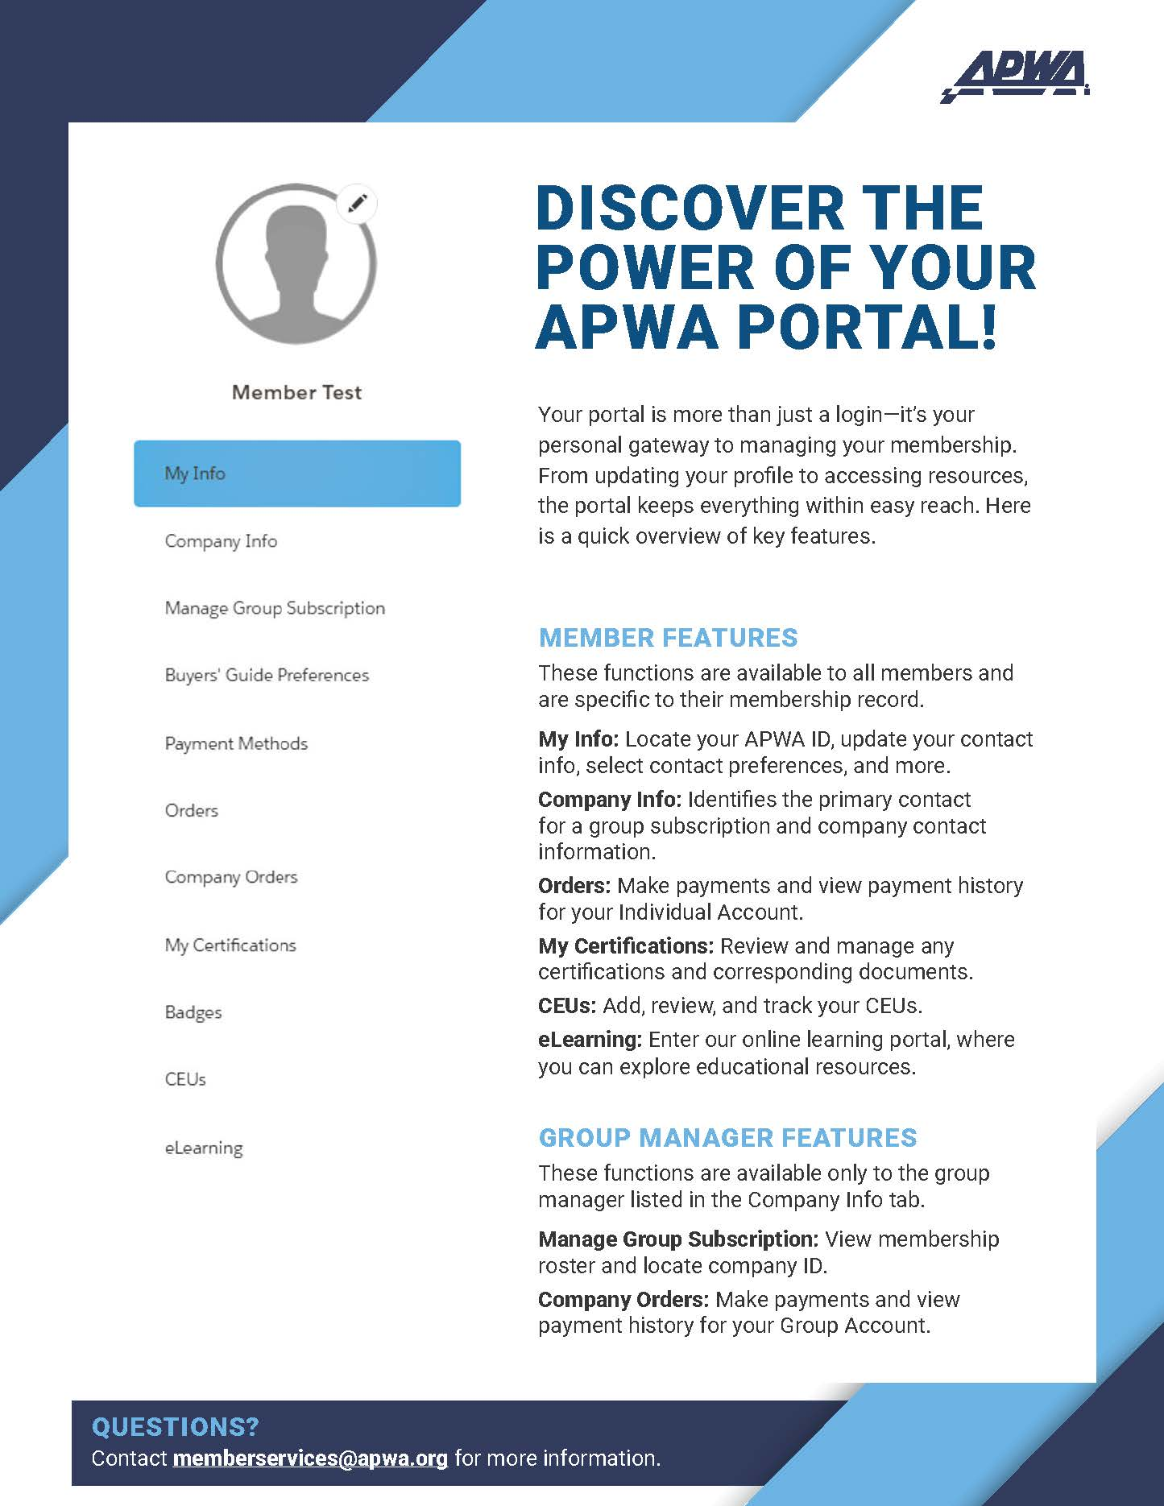
APWA Portal Quick Start Guide
The Membership Manual provides step-by-step guidance to help members make the most of their APWA membership, including:
Accessing the member portal
Resetting passwords
Renewing individual and group memberships
Updating member profiles
Tracking CEUs
Accessing member resources and benefits
Printable resources are available with just one click.

Slide 13
APWA Portal Quick Start Guide for Chapters
Share Resources with Your Members
The Membership Manual and Quick Start Guide are excellent resources to help members get the most from their membership.
  Encourage members to:
    Access the Member Portal.
    Update their profile.
    Renew their membership.
    Track CEUs.
    Explore educational opportunities.
    Take advantage of member benefits.
Chapter Tip: Include these resources in the welcome emails and feature them in your chapter newsletter.

Slide 14
Recruitment Challenges
Effective Communication
  Breaking through crowded inboxes and busy schedules.
  Creating a sense of urgency.
  Clearly demonstrating the value of membership to both individuals and their employers.
Demonstrating Local Value
  Answering the question, "What's in it for me and my organization?"
  Highlighting chapter meetings, educational programs, networking opportunities, and community engagement.
  Leveraging the APWA Events Calendar to showcase local opportunities.

Slide 15
Recruitment Challenges for Chapters
Chapters Can Make the Difference!
Challenge: Communicating Value
Members often ask:
"What's in it for me?"
"Why should my employer support membership?"
Your Chapter Can Answer By Highlighting:
Local networking opportunities.
Technical education and professional development.
Leadership and volunteer opportunities.
Scholarships and awards.
Mentoring and career growth.
Advocacy efforts that impact your community.

Slide 16
Recruitment Challenges for Chapters (cont)
Challenge: Keeping Members Engaged
Recruitment is only the first step.
Successful chapters:
  Welcome new members.
  Encourage committee involvement.
  Personally invite members to events.
  Follow up with members who haven't attended recently.
Chapter Tip: Recruitment begins with APWA, but long-term member engagement happens at the chapter level.

Slide 17
Five Things Your Chapter Can Do This Month!
Welcome every new member personally.
Invite a nonmember to your next event.
Contact five expired members.
Promote the Member Quick Start Guide.
Share your chapter's success stories with APWA Membership staff.

Slide 18
Questions?

