Slide 1
EPA mandates lead pipe removal
A look at the final rule and challenges facing water utilities

Slide 2
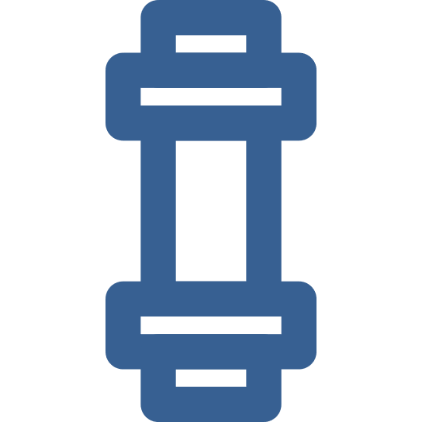
EPA finalized a rule requiring replacement of lead pipes by 2034
RULE OVERVIEW
On October 8, EPA finalized Lead and Copper Rule Improvements requiring water utilities to replace all lead pipes by 2034
The rule will establish a national inventory of lead service lines and require utilities to take action towards removing pipes on private property, among other provisions
School testing
Lower threshold
Lead pipe removal
The rule establishes the first national lead testing requirement for schools, affecting elementary and child-care facilities
The lead contamination level that triggers government enforcement has been lowered from 15 parts per billion (ppb) to 10 ppb
An initial inventory of pipes made of lead and unknown materials was due Oct. 16 2024; all lead pipes must be removed by 2034
Replacement
Funding
The rule does not specify material options for pipe replacement; common alternatives include copper and plastic
The project is expected to cost at least $45B. Biden previously allotted $15B for the project with an additional $2.6B made available with the final rule
SOURCE Washington Post.
PRESENTATION CENTER 10/24/24
Notes:
Sources:
Amudalat Ajasa, “In a landmark move, EPA requires removal of all US lead pipes in a decade,” Washington Post, October 8, 2024, https://www.washingtonpost.com/climate-solutions/2024/10/08/epa-lead-pipe-removal-rule-drinking-water/

Slide 3
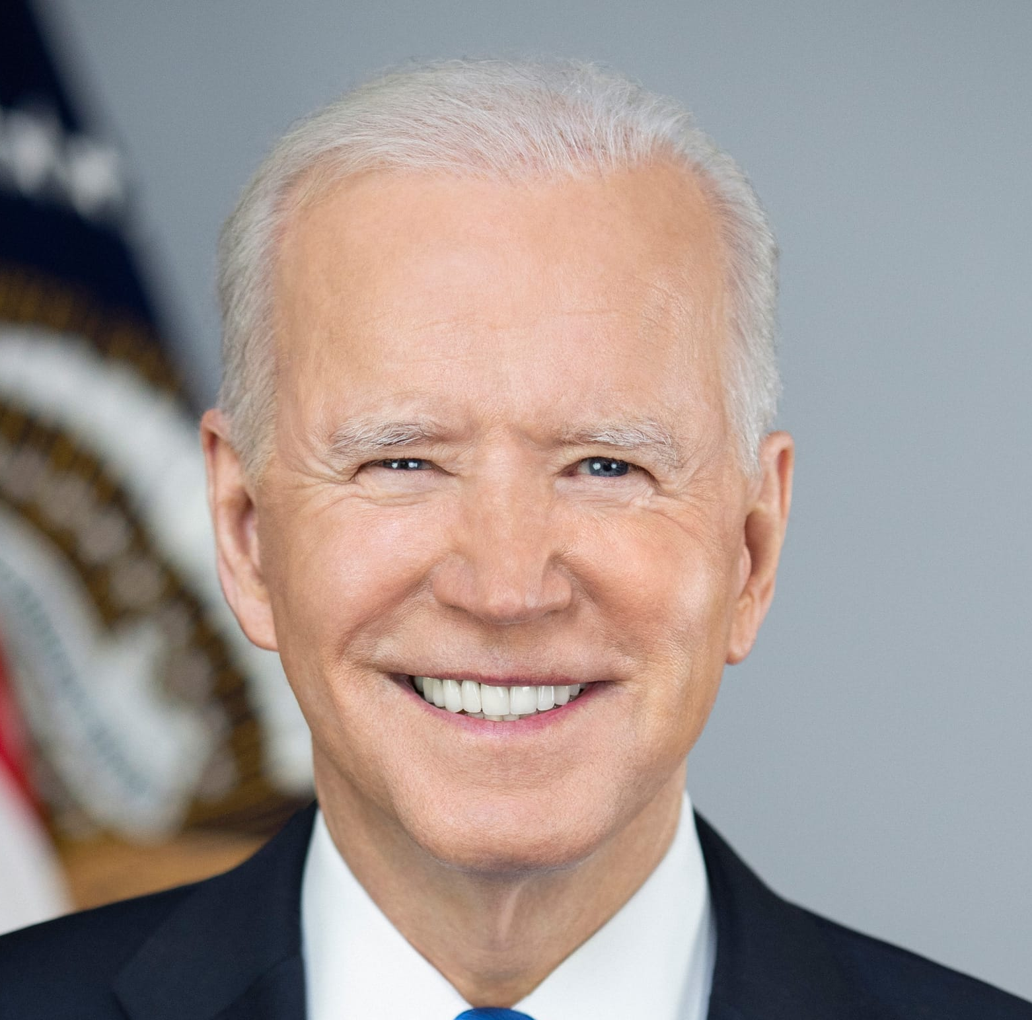
The rule is part of a Biden administration push on lead and other chemicals
BIDEN’S CHEMICAL CRACKDOWN
The Lead and Copper Rule Improvements accompany a series of administrative actions focused on lead and other chemicals in public water supplies; in April, landmark rules were issued limiting PFAS in drinking water
The rule repeals less stringent Trump-era regulations. Environmental advocates say reversing the new standards would be difficult with Trump as president
According to the White House, over 367,000 lead pipes have been replaced during the Biden administration, with cities like Milwaukee and Detroit on track to replace all lead pipes in the given timeline
EPA announced $35M in grant funding to reduce lead in drinking water outside of pipe replacement, and it has also taken steps to regulate lead in air, soil, and household products
In October 2024, EPA finalized a rule strengthening requirements for removing lead paint dust in pre-1978 housing and childcare facilities
LEAD HEALTH RISKS
The World Health Organization identifies lead as a chemical of major public health concern, particularly for children; young children may absorb up to 5 times as much lead as adults from an ingested dose
Exposure to high levels of lead can lead to brain and nervous system damage in children, as well reduced IQ, behavioral changes, and immunotoxicity
EPA estimates that once the rule is fully implemented, it will prevent low birth weight in up to 900,000 infants and avoid up to 1,500 cases of premature death from heart disease
“For too long, local communities have known how important it was to deal with this problem. It hadn’t been given the national priority it demanded, though. I’m here to tell you that I am finally insisting that it gets prioritized, and I’m insisting it get done.”
PRESIDENT BIDEN
SOURCE Washington Post, White House, EPA, WHO.
PRESENTATION CENTER 10/24/24
Notes:
Sources:
Amudalat Ajasa, “In a landmark move, EPA requires removal of all US lead pipes in a decade,” Washington Post, October 8, 2024, https://www.washingtonpost.com/climate-solutions/2024/10/08/epa-lead-pipe-removal-rule-drinking-water/
“Biden-Harris Administration Issues Final Rule Requiring Replacement of Lead Pipes Within 10 Years, Announces Funding to Provide Clean Water to Schools and Homes,” EPA, October 8, 2024, https://www.epa.gov/newsreleases/biden-harris-administration-issues-final-rule-requiring-replacement-lead-pipes-within#:~:text=WASHINGTON%20%E2%80%93%20Today%2C%20October%208%2C,lead%20pipes%20within%2010%20years.
“FACT SHEET: Biden-⁠Harris Administration Strengthens Standards to Protect Millions from Exposure to Lead Paint Dust, Announces New Actions to Address Toxic Lead Exposure,” The White House, October 24, 2024, https://www.whitehouse.gov/briefing-room/statements-releases/2024/10/24/fact-sheet-biden-harris-administration-strengthens-standards-to-protect-millions-from-exposure-to-lead-paint-dust-announces-new-actions-to-address-toxic-lead-exposure/
“Lead poisoning,” World Health Organization, September 27, 2024, https://www.who.int/news-room/fact-sheets/detail/lead-poisoning-and-health

Slide 4
Most lead pipes in need of replacement are located on the East Coast and in the Midwest
Lead service lines per state
SOURCE: NRDC
■ 0-70K ■ 70K-200K ■ 200K-360K ■ 360K-660K ■ 660K-1.1M
WA
MT
ND
VT
ME
OR
MN
NH
ID
SD
WI
NY
WY
MI
NV
NE
IA
OH
PA
UT
CO
IL
IN
WV
CA
KS
MO
KY
VA
AZ
TN
NC
MA
NM
OK
AR
SC
MS
AL
GA
RI
AK
TX
LA
CT
NJ
HI
FL
DE
MD
SOURCE NRDC.
PRESENTATION CENTER 10/24/24
Notes:
“Finding Lead Water Pipes: New NRDC Map Shows the Hot Spots in Every State,” NRDC, September 15, 2024, https://www.nrdc.org/resources/lead-pipes-are-widespread-and-used-every-state

Slide 5
Utilities providers concerned about high costs and quick turnaround
Major challenges associated with lead pipe replacement
9.2 M
Lead service lines are currently in use in all 50 states
PRIVATE PROPERTY ACCESS
Though not required by the rule, water systems may lack clear legal authority to replace portions of lead service lines (LSL) on private property
POTENTIAL LEGAL ACTION
HIGH COSTS
In 1991, the American Water Works Association (AWWA) successfully sued EPA over regulations that made utilities responsible for the entirety of lead service lines, rather than upholding private property standards
AWWA and the Association of Metropolitan Water Agencies have already challenged the new PFAS drinking water regulations. It is unclear whether these groups will sue over the new regulations
The Trump administration may seek to make alterations and provide relief
Replacing an LSL can cost over $10K; estimates for total LSL replacement are over $90B, far exceeding the $15B in federal funding
SHORT TIMELINE
Even with some exceptions to the deadline, it may be unrealistic to remove and replace the extensive LSL system in 10 years
SOURCE Washington Post, ASCE, NRDC.
PRESENTATION CENTER 10/24/24
Notes:
Sources:
Jay Landers, “US EPA proposes 10-year deadline to remove lead service lines,” American Society of Civil Engineers, January 16, 2024, https://www.asce.org/publications-and-news/civil-engineering-source/civil-engineering-magazine/article/2024/01/us-epa-proposes-10-year-deadline-to-remove-lead-service-lines
Amudalat Ajasa, “In a landmark move, EPA requires removal of all US lead pipes in a decade,” Washington Post, October 8, 2024, https://www.washingtonpost.com/climate-solutions/2024/10/08/epa-lead-pipe-removal-rule-drinking-water/
“Finding Lead Water Pipes: New NRDC Map Shows the Hot Spots in Every State,” NRDC, September 15, 2024, https://www.nrdc.org/resources/lead-pipes-are-widespread-and-used-every-state

