Slide 1
Agency Accreditation with APWA
Notes:
Welcome, everyone! I’m glad you could join us today. Whether you’re new to accreditation or have some experience with it, this session is all about exploring how accreditation can strengthen public works agencies and the critical role it plays in building excellence and continuous improvement.
We’ll dive into why accreditation matters, not just as a badge of honor, but as a powerful framework that helps agencies document their processes, support leadership transitions, improve efficiency, and even boost credibility with stakeholders like elected officials and insurers.
Today is a chance to learn from each other, share ideas, and get inspired about how accreditation can elevate the work we do every day to serve our communities better. So, let’s get started and take this opportunity to grow, connect, and explore what accreditation means for public works.

Slide 2
Accredited Agencies in [ ] Chapter
Contact us at accreditation@apwa.org for a current list of accredited agencies in your chapter and agencies that have applied to become accredited.
Notes:
Please contact us and we will provide the most up to date information for your chapter.

Slide 3
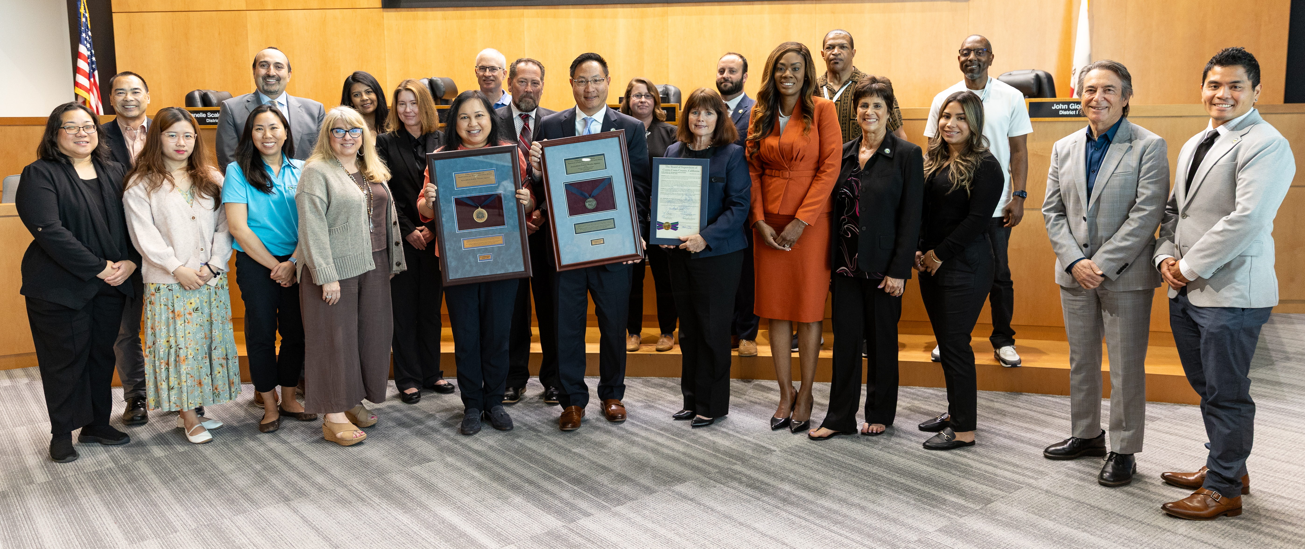
Notes:
This photo shows the dedicated staff of the Contra Costa County, California, Department of Public Works alongside APWA Regional Director Joubin Pakpour at the presentation of their accreditation plaque.
This event took place at the Board of County Commissioners meeting, recognizing the agency’s hard work and commitment to excellence.
It’s a powerful reminder that accreditation is not just about a plaque; it’s about the people who make it happen and the commitment they have to their community.

Slide 4
Education and Credentialing Department
APWA is committed to providing excellence in education and credentialing by creating exceptional learning experiences for all levels of public works professionals.
Notes:
Let’s talk about the “who” behind the APWA Accreditation program, who actually manages it, and makes it all happen? Right now, the program is run by a team of three full-time dedicated staff members who focus solely on accreditation, plus an associate who provides additional support. The accreditation team provides valuable resources, delivers training, and ensures the program is consistent and fair for agencies across North America. But it doesn’t stop there, they also work with a large network of trained volunteer evaluators from across the country. Oversight is provided by the Accreditation Council, which helps guide the program’s long-term goals.
But APWA’s offerings go beyond just agency accreditation. There are five different certification programs designed specifically for individuals looking to grow their skills and advance their careers in public works. In addition, APWA offers a variety of certificate programs that focus on specialized topics, providing targeted learning opportunities to build expertise in key areas. Alongside these, there’s a digital resource center packed with webinars, Click-Listen-And-Learns, toolboxes, and more. So, there’s always something new to learn and plenty of ways to stay connected with the latest industry knowledge.
(Please mention any additional educational resources your chapter offers its members)

Slide 5
What is Accreditation?
The APWA Accreditation Program provides an opportunity for public works agencies to earn accreditation after completion of an evaluation and review process.
The evaluation and practice review process serves to provide a means of formally verifying and recognizing public works agencies for compliance with the recommended practices set forth in the Public Works Management Practices Manual.
It is a voluntary, self-motivated approach to objectively evaluate, verify, and recognize compliance with the recommended management practices.
Notes:
The Accreditation Program is a voluntary process that gives public works agencies the opportunity to earn recognition for following best practices and demonstrating excellence in service delivery.
Through this program, agencies undergo a thorough evaluation to determine whether they meet the standards outlined in the Public Works Management Practices Manual.
These standards cover a wide range of operations, from administration and finance to maintenance and emergency management. The accreditation process is a valuable way for agencies to self-assess, identify areas for improvement, and implement changes that ultimately make them stronger, more efficient, and better prepared to serve their communities.
When an agency achieves accreditation, it demonstrates to staff, leadership, and the public that it is committed to continuous improvement and accountability.

Slide 6
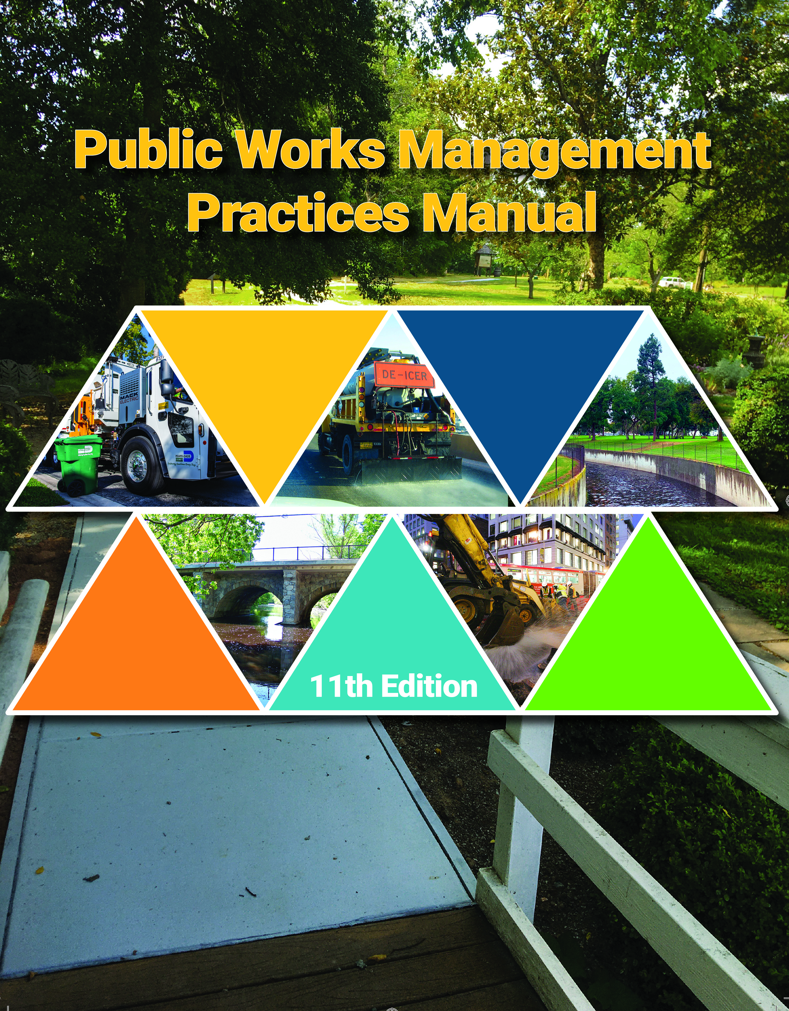
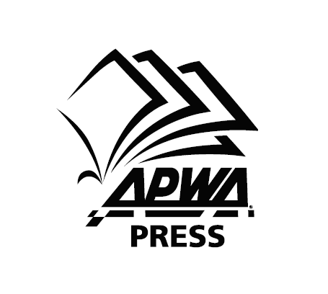
The Public Works Management Practices Manual is a collection of 529 recommended best practices developed by knowledgeable public works professionals located throughout North America.
  11th Edition was published August 2023.
  12th Edition will be published August 2027.
Notes:
The Public Works Management Practices Manual is a fundamental resource for public works agencies aiming to enhance their operations and service delivery. It is updated every four years to reflect the evolving needs, trends, and challenges within the public works field. Importantly, each edition incorporates input from current professionals actively working in the industry, ensuring the content remains relevant, practical, and aligned with real-world practices.
While the manual is a required component of the accreditation process, it serves a broader purpose as well. Agencies use it as a valuable tool to conduct a thorough self-assessment, essentially performing a gap analysis, to identify strengths and areas for improvement within their core functions.
To support this process, the manual is offered alongside self-assessment software. This software not only facilitates the self-assessment but also functions as the primary portal for managing the formal evaluation. It helps agencies efficiently organize documentation, track progress, and streamline the accreditation journey

Slide 7
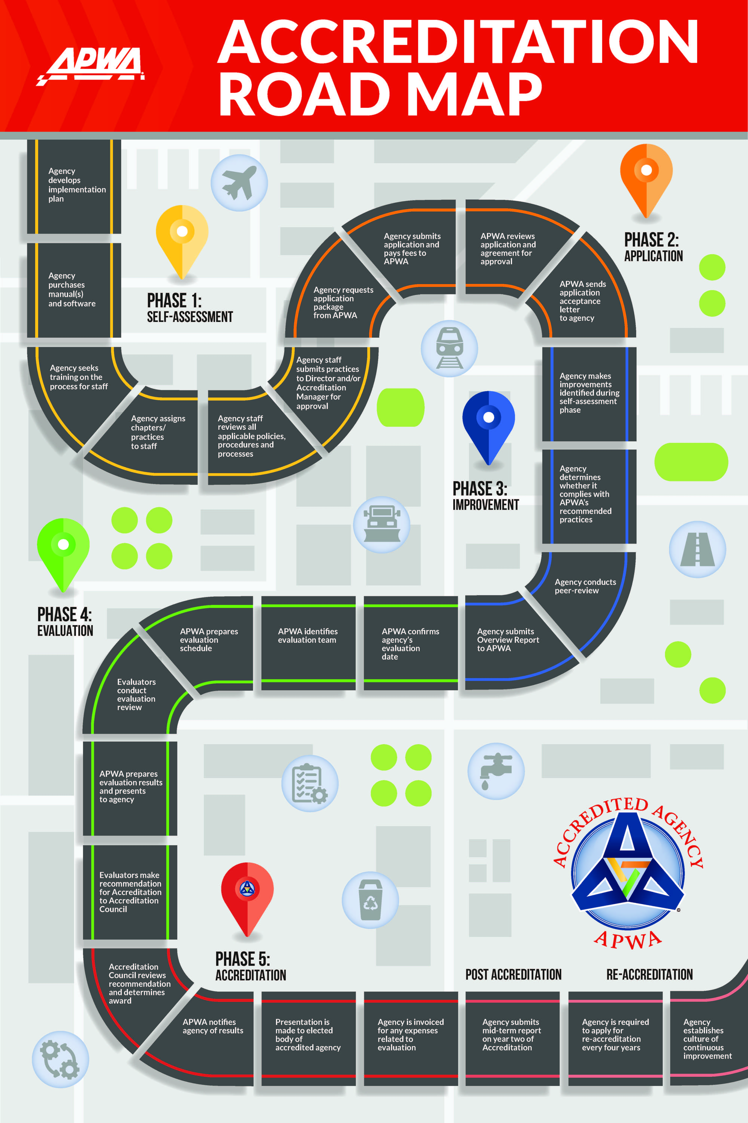
Five phases of Accreditation:
Phase 1: Self-Assessment
Phase 2: Application
Phase 3: Improvement
Phase 4: Evaluation
Phase 5: Accreditation
Notes:
Every journey needs a map, and accreditation is no different!
It’s important to remember that Phase 1 and Phase 2 can be completed in either order. Some agencies prefer to start with a self-assessment, using that as a way to really understand their current practices and identify areas for improvement before they apply. Others are ready to jump right in, apply first, and then dive into the self-assessment with a fresh perspective and the support of APWA.
Whichever path works best for your agency, we’re here to help you navigate it. I encourage you to talk with the APWA staff about the application process and how to get started. We want to make sure you feel supported at every step of the journey

Slide 8
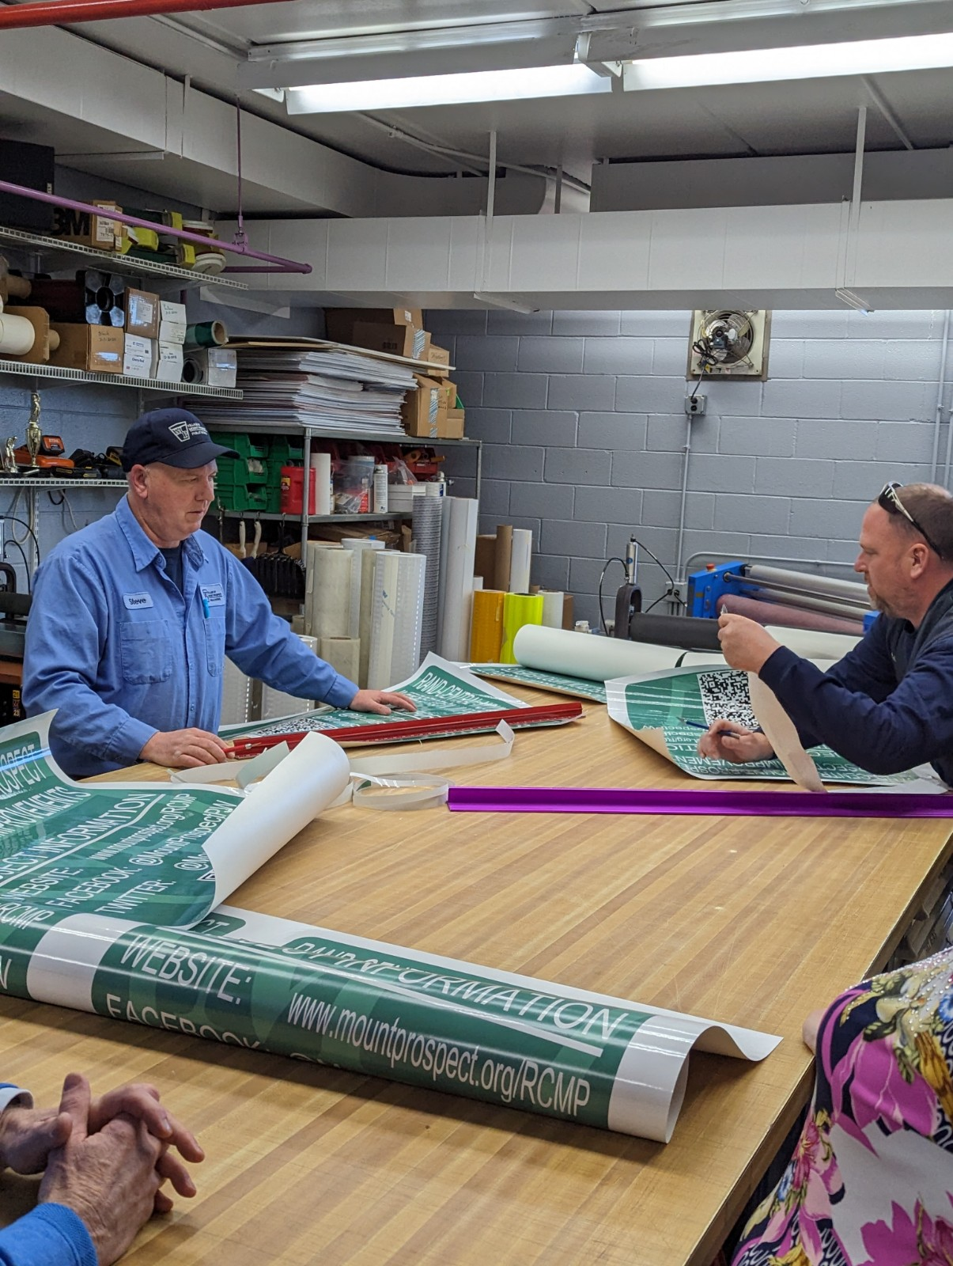
Why Seek Accreditation?
Established agency-wide culture of continuous improvement
Succession planning/institutional knowledge retention
Central location for documentation
Reduced duplication and wasted resources
Justification for budget requests
Lowering of insurance premiums
Reduced liability
Notes:
You know, one of the great things about accreditation is how it helps create a culture that’s always looking to improve. It’s not just a one-time thing you check off, it encourages everyone on staff to keep asking, “How can we do this better?”
That mindset sticks and drives ongoing progress. Another big benefit is how accreditation makes sure all the important processes and knowledge are documented. That’s huge when you bring on new staff, they can get up to speed faster without having to hunt around for info. Plus, having a solid repository of policies and procedures means less time wasted searching and more time spent actually delivering great services.
Accreditation also pushes agencies to take a hard look at their processes: where things might overlap or be inefficient. Cutting down on duplicated efforts means better use of resources, saving time and money in the long run. And from a funding perspective, having that accreditation framework gives you solid, organized documentation and data to support budget requests. It’s much easier to clearly show why your public works agency needs certain resources to meet its goals.
Finally, there’s often an insurance advantage too. Insurers tend to view accredited agencies as lower risk because they show strong management practices. That can sometimes translate to lower premiums, which is a nice bonus, protecting your staff and community while keeping costs down.

Slide 9
Ask yourself…
Have we been doing the same processes for more than three years? If yes:
Is it still efficient?
When was the last time our processes were reviewed?
How do your processes align with best practices?
Does everyone within your department have a clearly defined succession plan?
Notes:
Succession planning, it’s something we all know is important, but let’s be honest, it’s not easy. It takes real effort to put solid plans in place, and even when you do, those plans can’t just sit on a shelf. They need to be reviewed regularly and updated to keep up with changes in your team, your agency, and the challenges you face.
Here’s a question I want you to think about: If even a quarter of your leadership team walked out the door tomorrow, would your agency be ready to keep running smoothly?
It’s a tough question, but it’s exactly why succession planning matters and accreditation can fit into the planning process. Being prepared means less disruption, more confidence that your agency can keep delivering great service, no matter who’s stepping in.

Slide 10
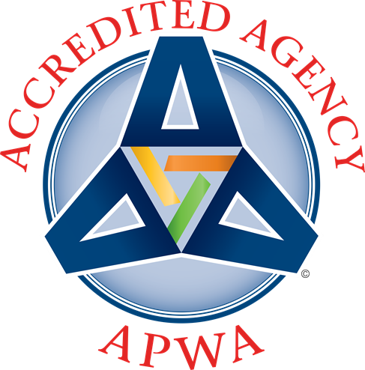
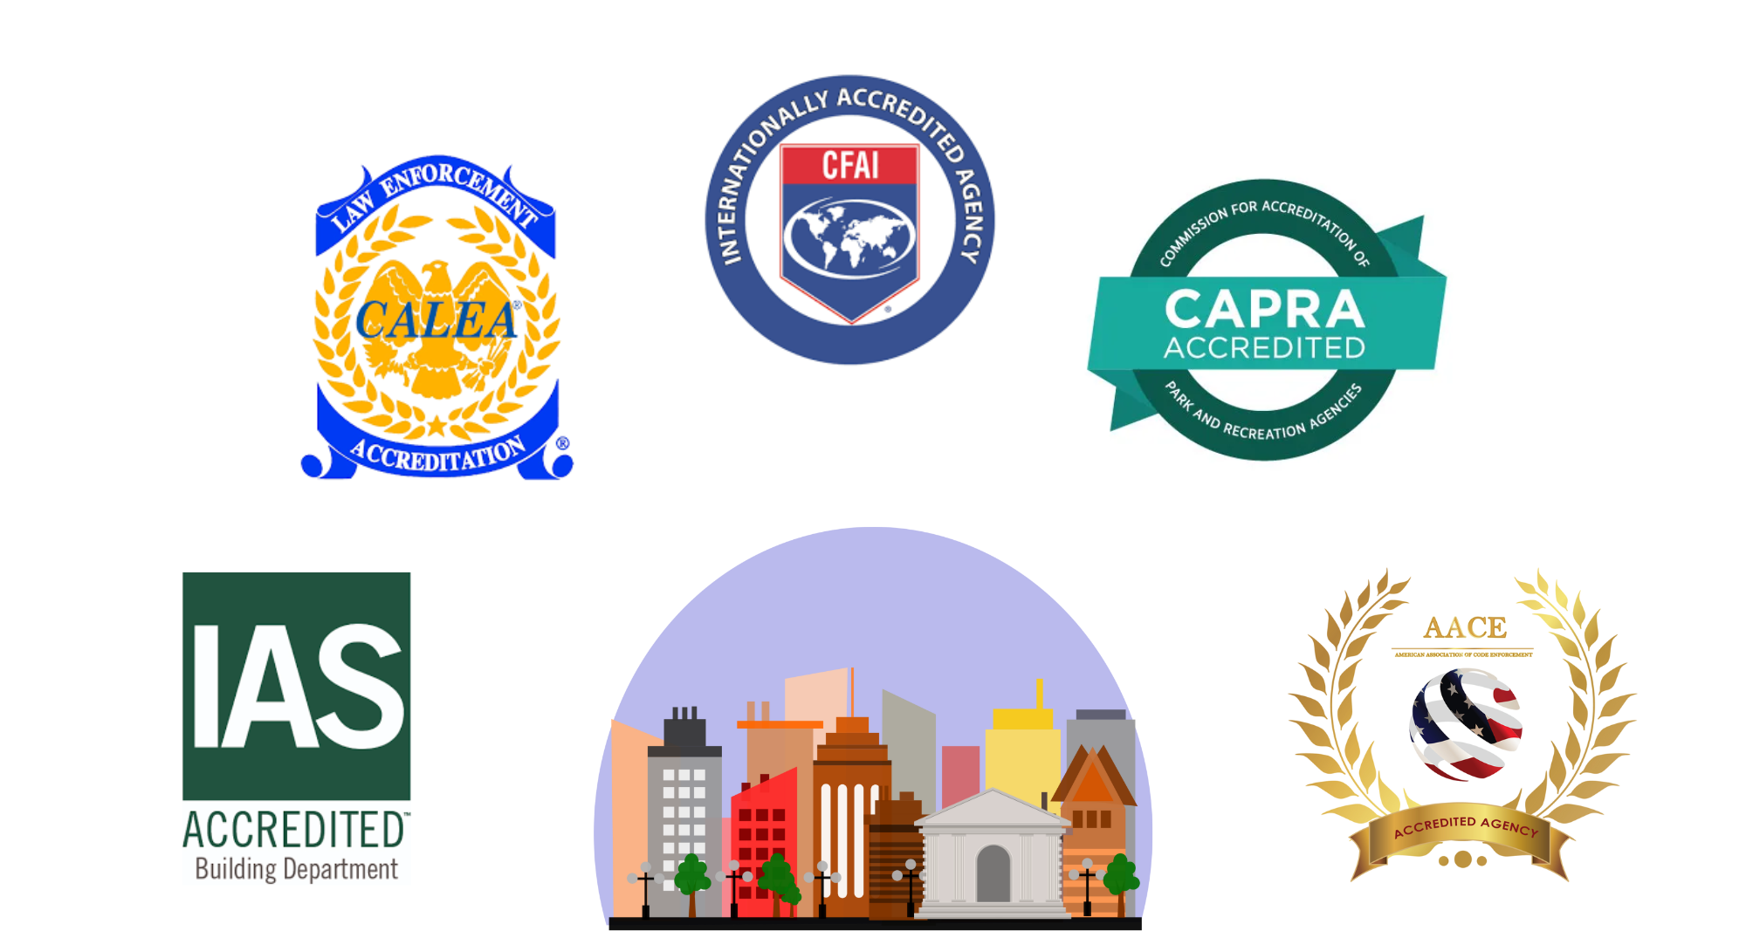
Notes:
When a public works department becomes accredited, it’s joining a broader community of accredited departments within its larger organization. Think about it: Police, Fire, Parks, Building Departments, and Code Enforcement all have their accreditation programs. Each one of those shows a commitment to excellence and professionalism within their area. Public works deserves that same recognition, and that’s exactly why APWA stepped up to create an accreditation program specifically for public works agencies.
It fills an important gap, helping public works get the spotlight it deserves as a key part of the organizational structure and the overall mission to deliver quality public service.
And this program isn’t new. It’s been around since 1997. The first agency to earn this accreditation was Greeley, Colorado. Since then, many agencies have followed.

Slide 11
How Can We Help Your Agency?
What challenges is your agency currently facing?
Where could you use support or additional resources?
Are there processes or practices you’d like to improve?
What training or tools would benefit your staff?
Are there areas where the chapter could make a difference?
How can we best support your agency’s unique needs?
Notes:
We’d love to hear more about the specific challenges you’re seeing right now.
Sometimes it’s not just about big changes, it might be targeted support or help with a particular issue. Let’s explore where we can offer that assistance.
We know that continuous improvement is important, and the accreditation process can help your agency improve, not just now, but in the future.
Let’s talk about what’s missing or where we might be able to help.
The chapter is here as a resource. Are there ways we can work together?

Slide 12
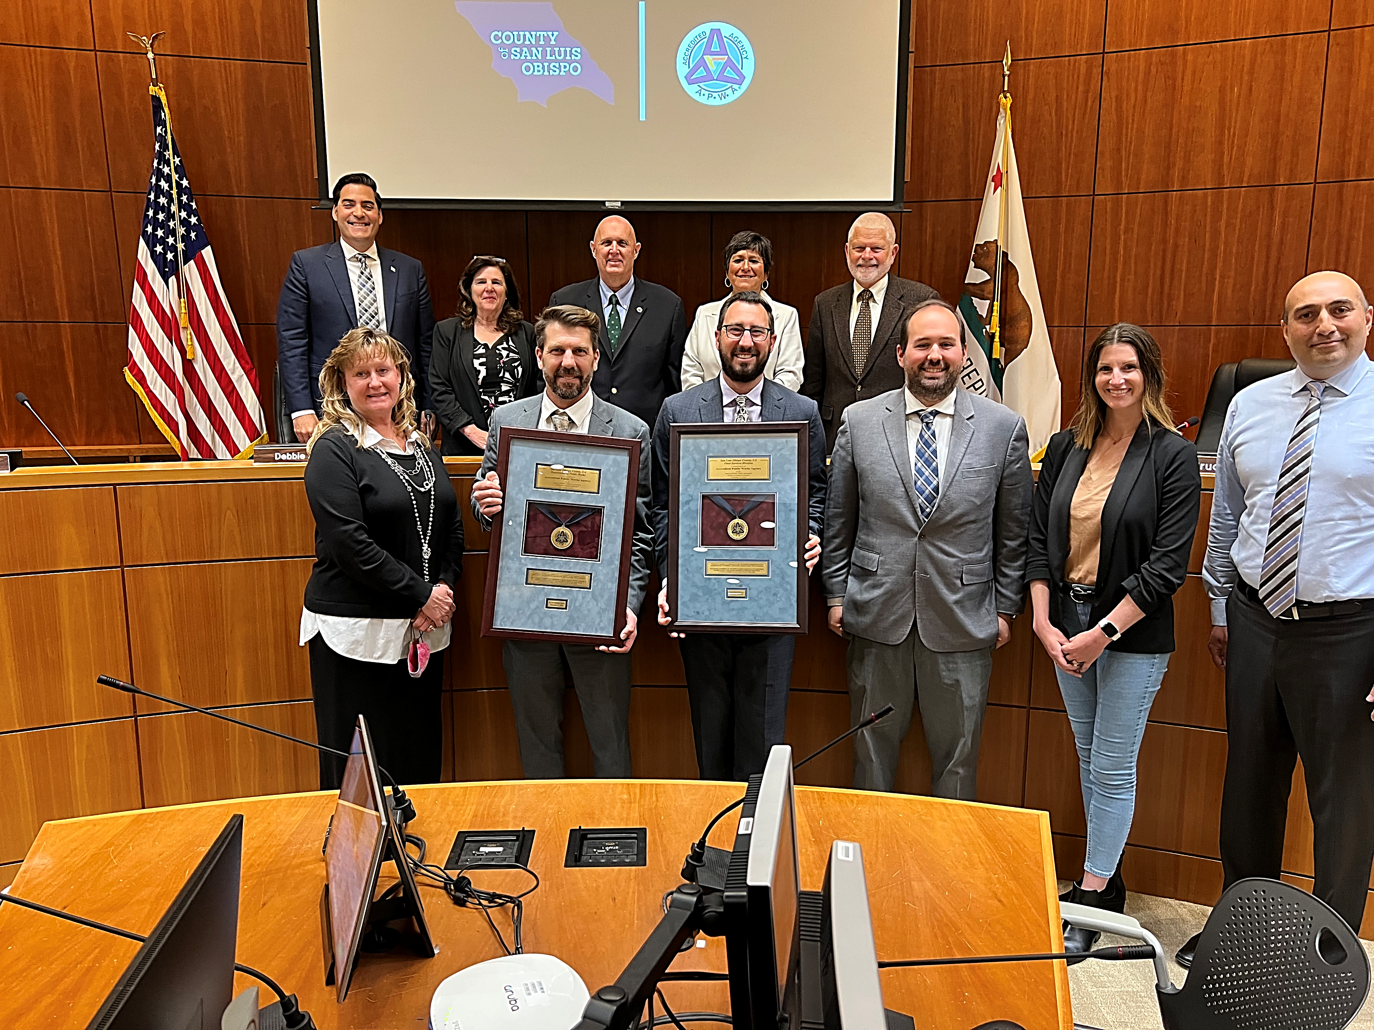
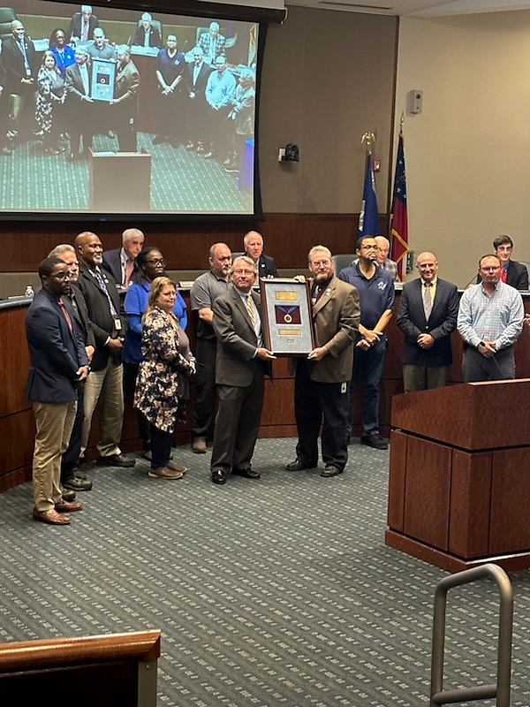
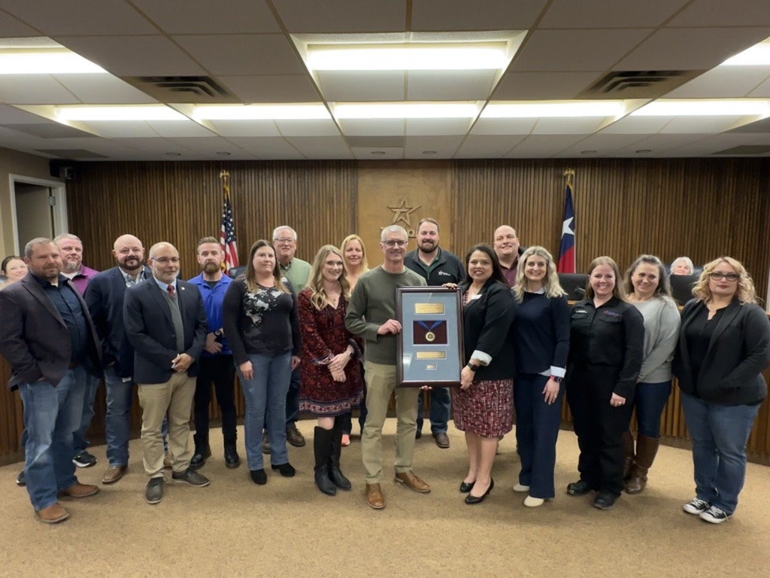
Notes:
Here, you can see some of the amazing agencies we’ve celebrated at their plaque presentations. Each of these photos represents a huge commitment to excellence and continuous improvement.
Our chapter takes great pride in recognizing agencies that have achieved accreditation, not just for completing the necessary steps, but for going above and beyond to serve their communities.
We want to make sure every agency feels that sense of celebration and pride when they reach this milestone, and until then, we’re here to support your agency every step of the way.

Slide 13
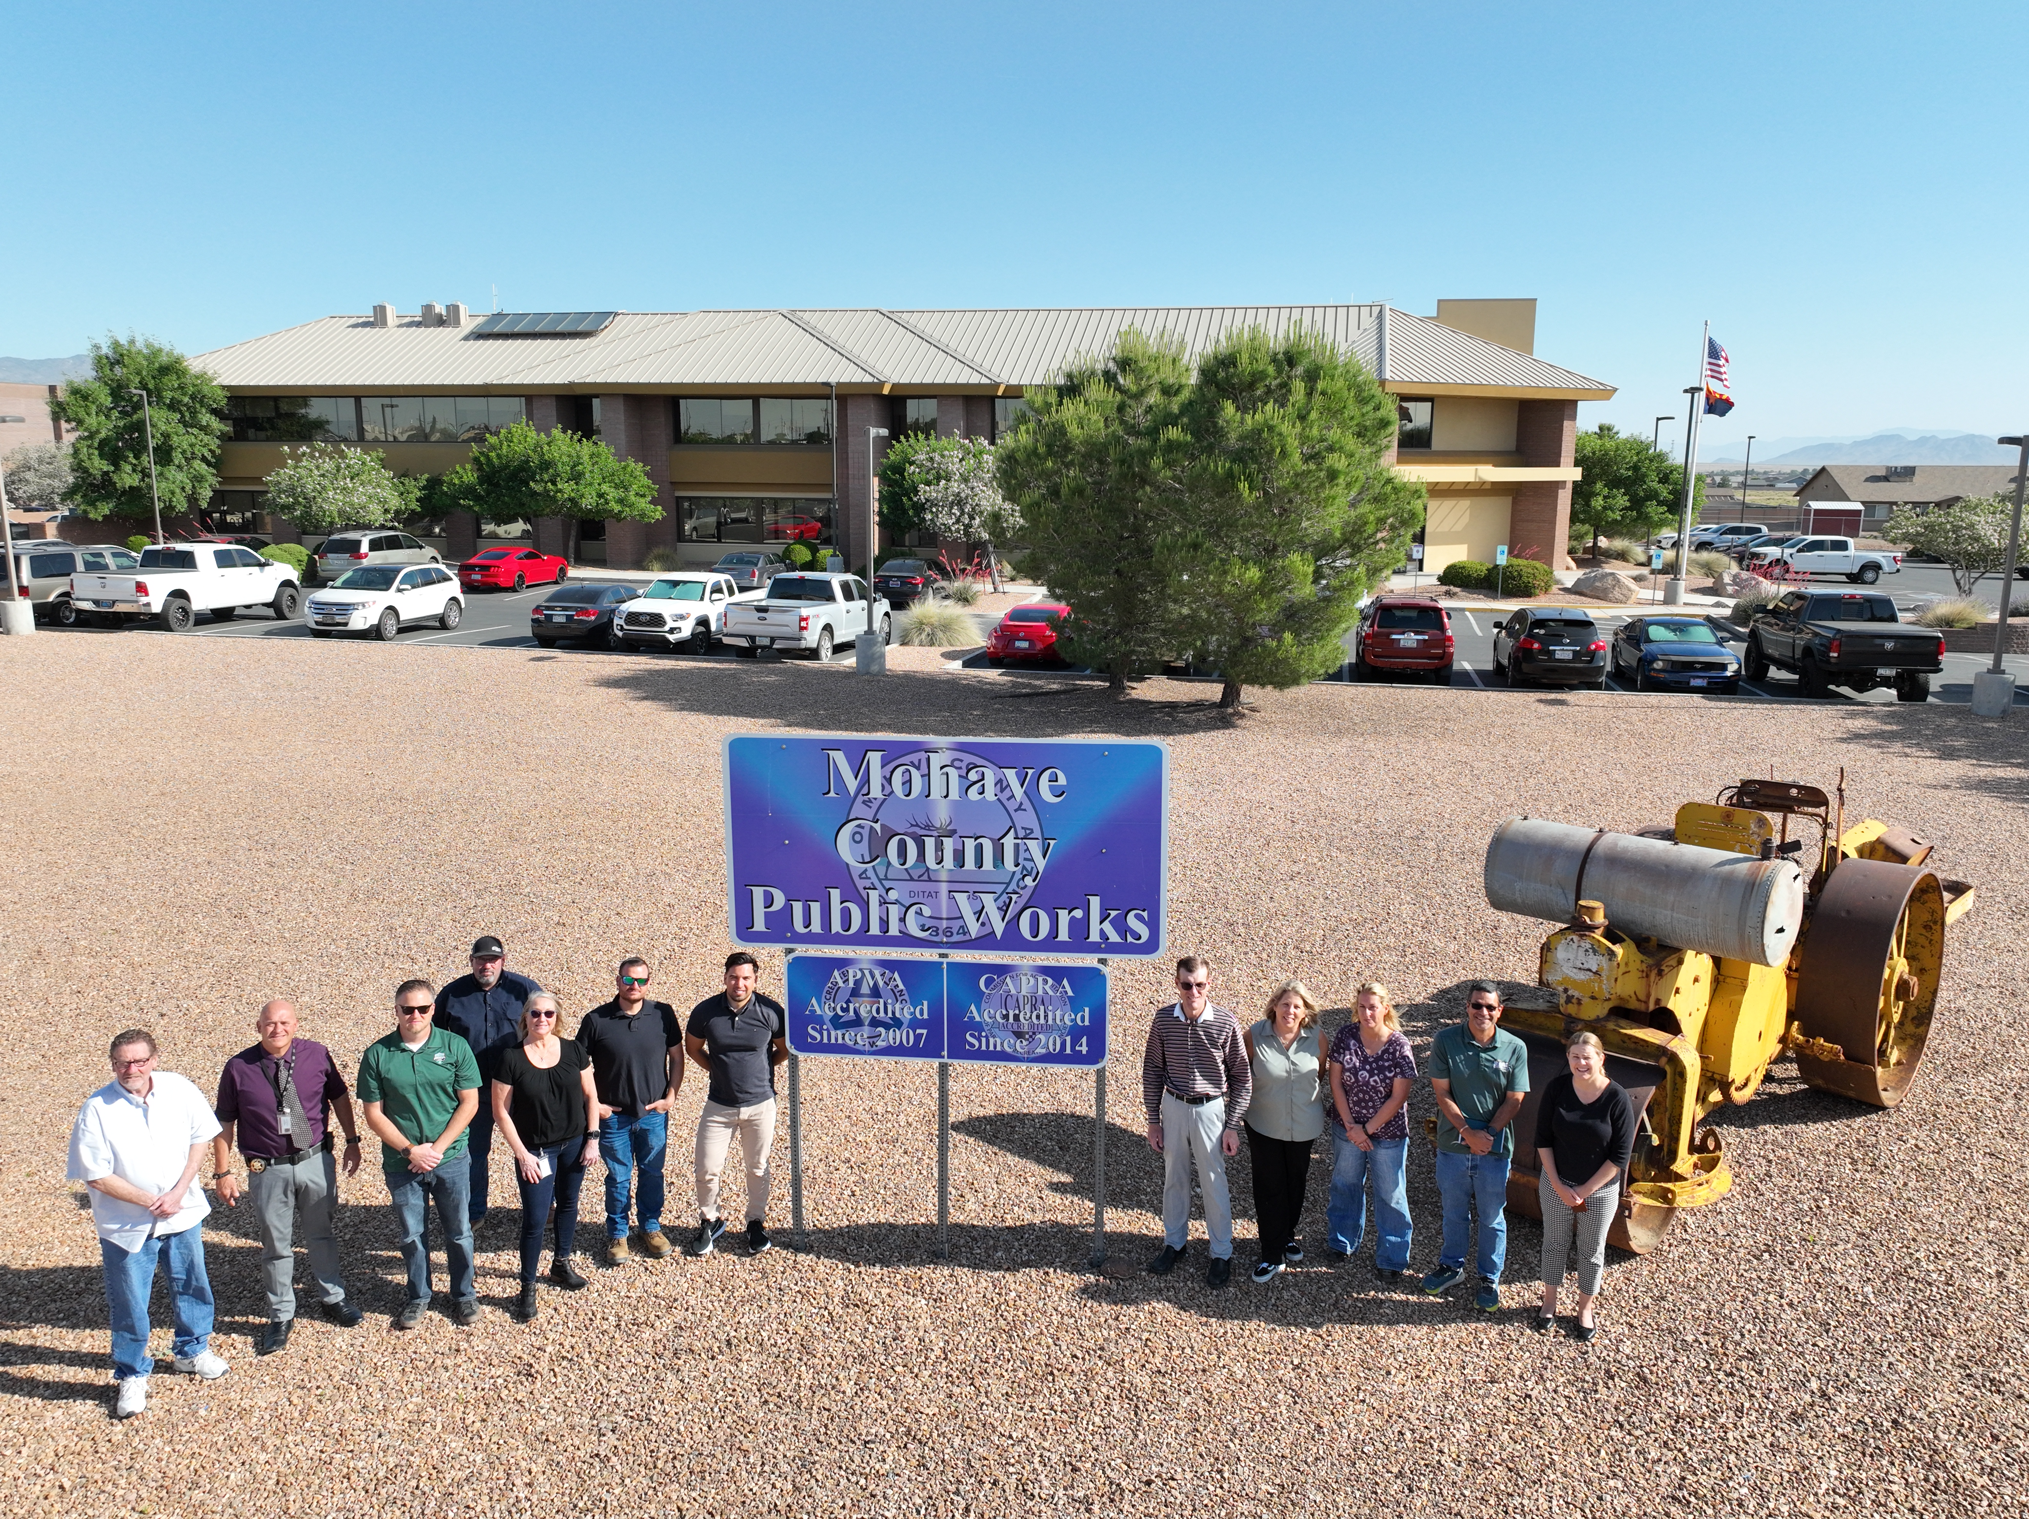
“APWA accreditation punctuates my agency’s delivery of services to the very best in public works practices. An APWA accredited agency reflects its staff as public works professionals working under a sound, efficient business model.
On a macro-level, APWA accreditation provides ongoing peer-to-peer exchange that affords agencies continuous opportunity to learn and improve.
Accredited agencies represent a community of subject matter experts in the management practices they deliver, and as a whole, we see ourselves as ambassadors for the public works profession.”
Steven P. Latoski, P.E., PTOE
Director of Public Works
Mohave County, Arizona Public Works Department
Notes:
APWA National has additional pieces of testimony if you’d like to hear more from other agencies that have become accredited. Also, check your monthly issue of the Reporter magazine for articles from accredited agencies.

Slide 14
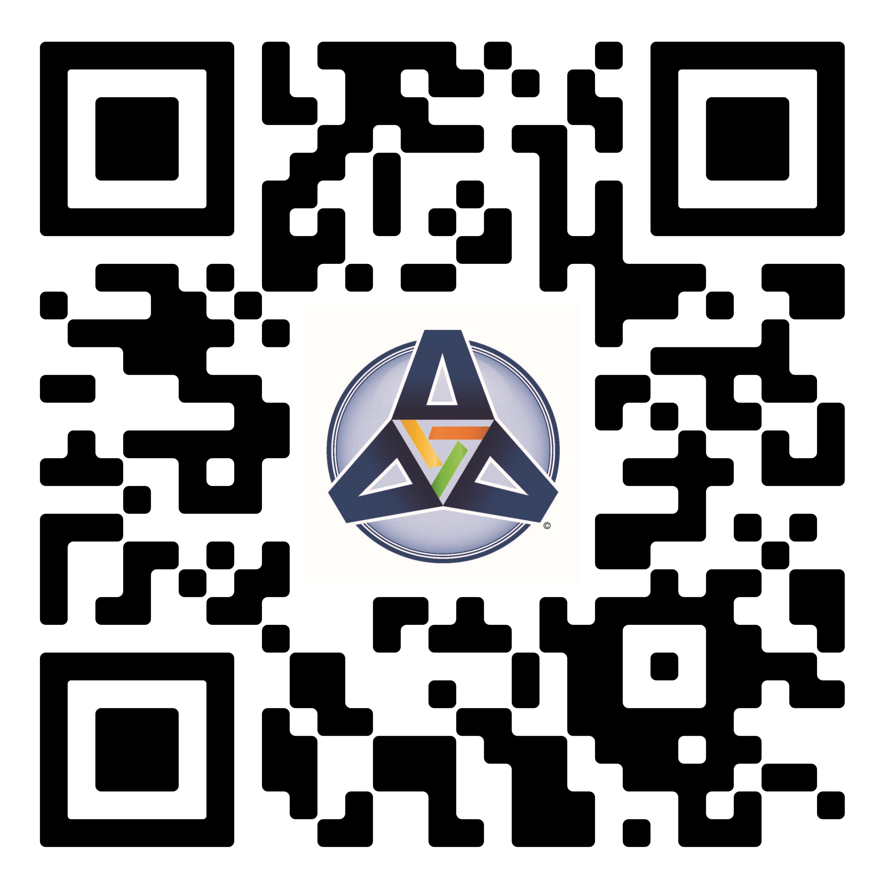
To connect to the Accreditation website (to see who is already accredited outside of your chapter, access resources, and more) scan this code.
Notes:
(You can invite attendees to use their mobile devices, open the camera app, and scan this QR code which will take them directly to the APWA accreditation website.)

Slide 15
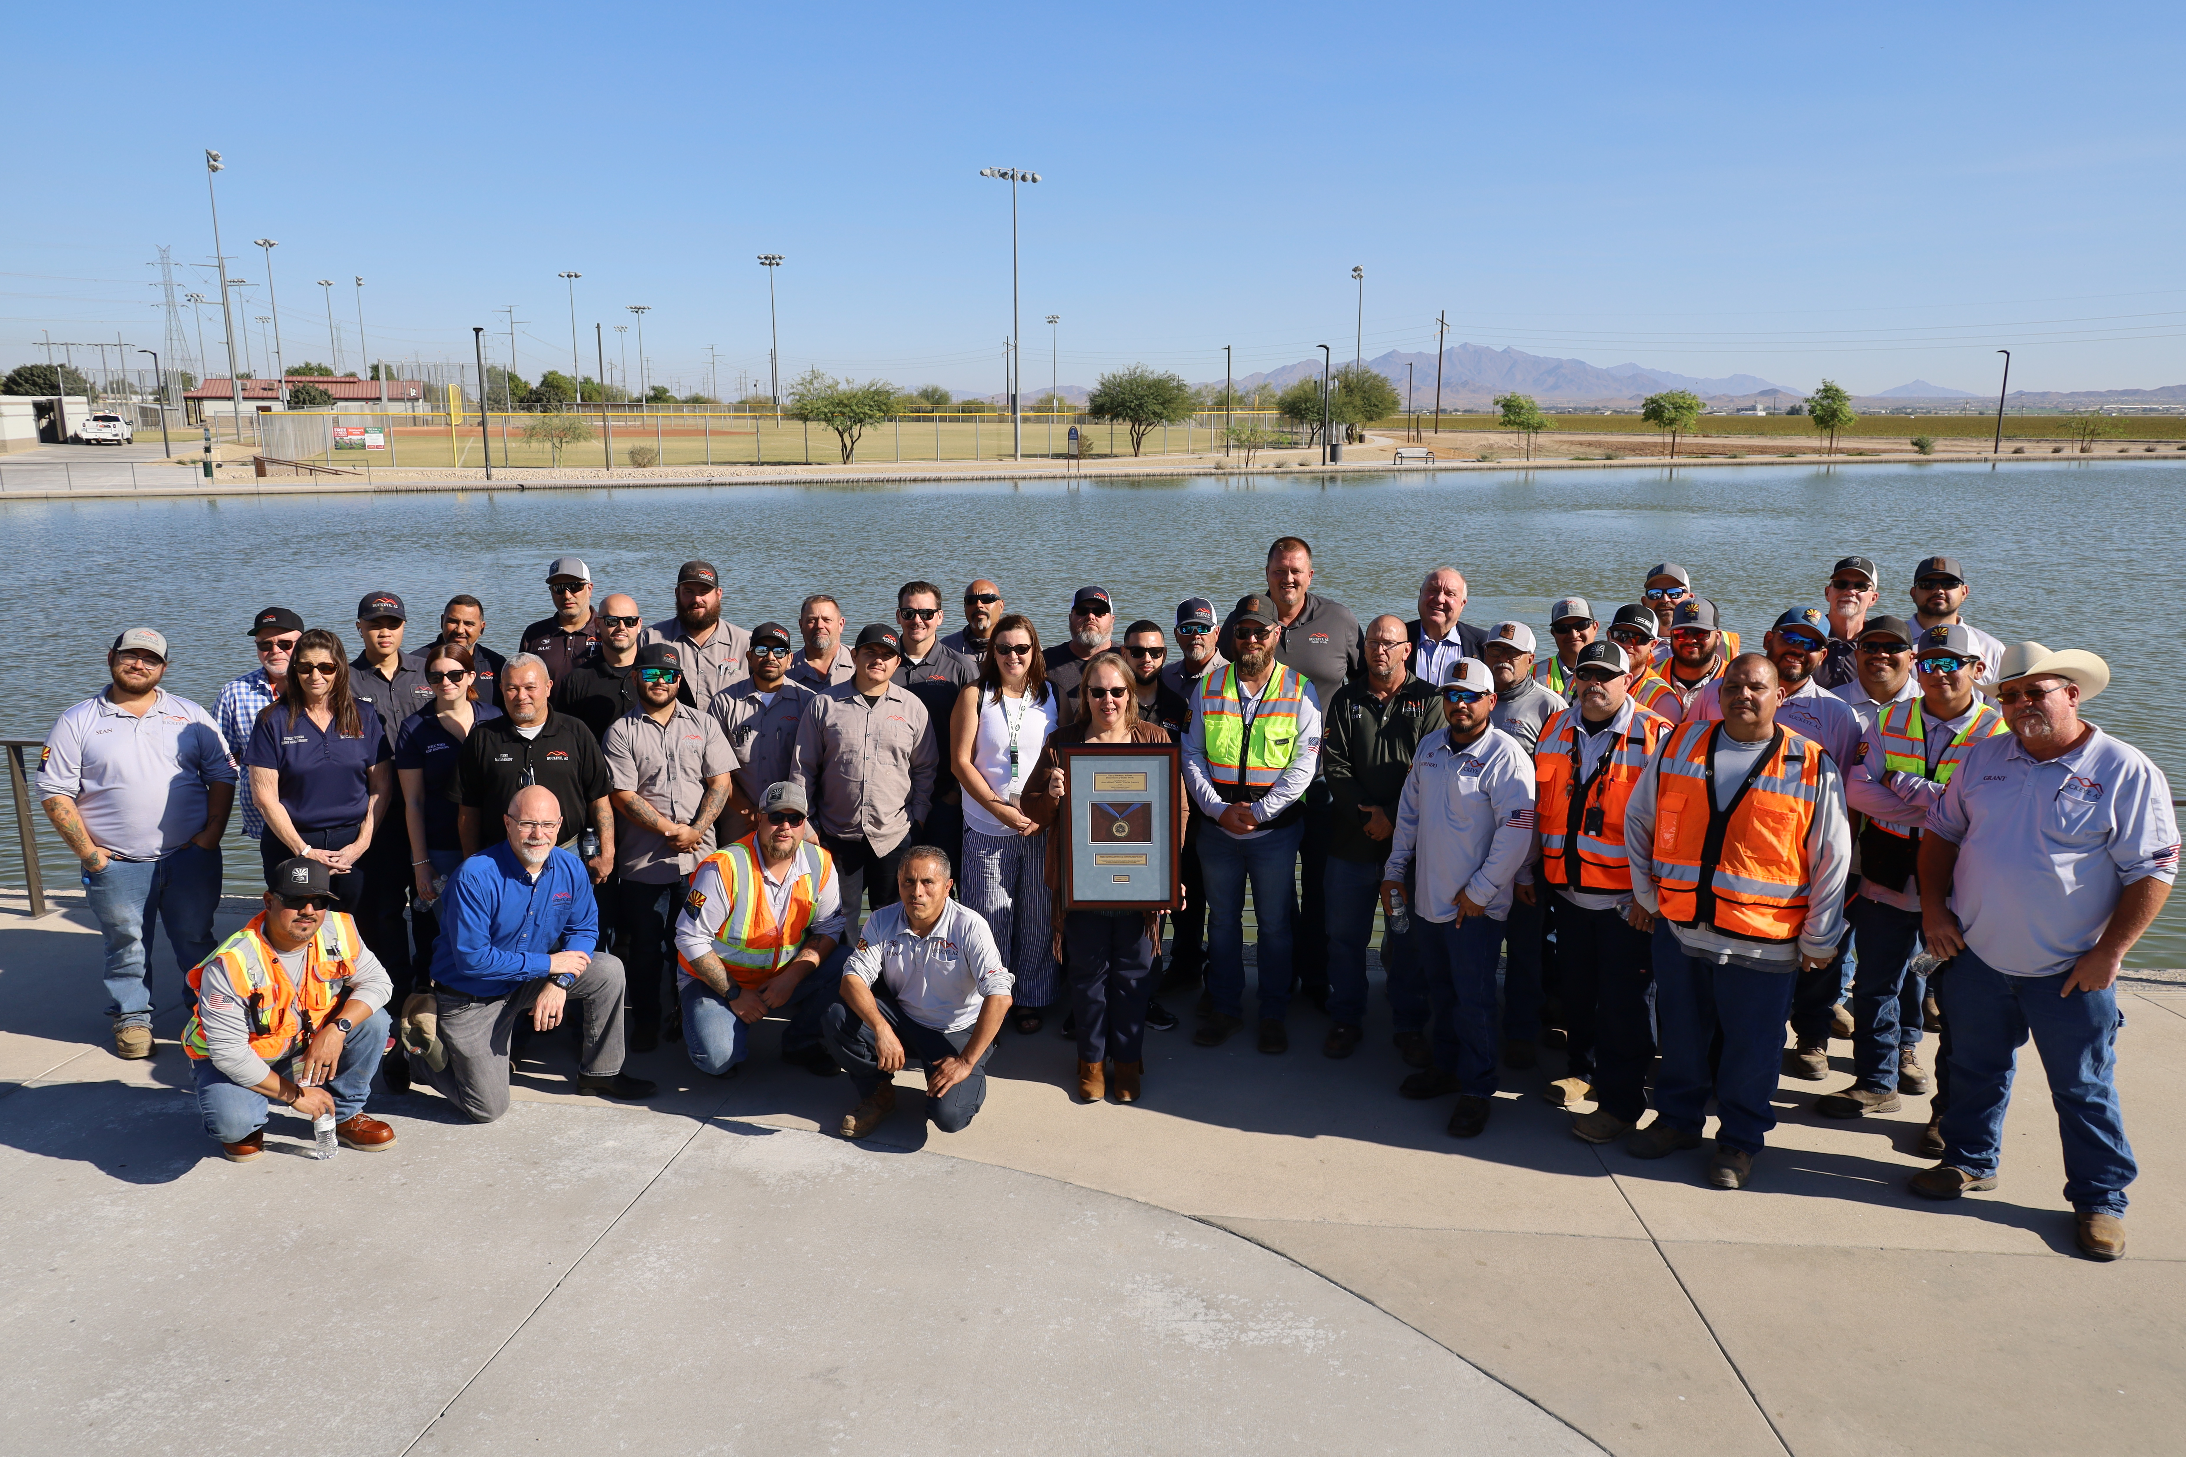
Presenter Name
Title
Organization Name
email@address.gov
Phone
APWA Accreditation Team
accreditation@apwa.org
Notes:
Thank you for your time! If you’d like to connect with me directly, here is my contact information, and the contact information for the APWA accreditation team. They have three full-time staff members who can assist with any questions or concerns, and would be happy to help.

