Slide 1
Leveraging APWA Accreditation & Certification to Strengthen Your Chapter
Monday, April 13, 2026
12:00 PM CT

Slide 2
Learning Objectives
After viewing this program, participants will be better able to:
Describe the value and purpose of APWA Accreditation and Certifications.
Identify opportunities within chapter activities to highlight APWA credentialing and what benefits it has for the chapters.
Support APWA credentialing awareness through existing chapter communications and available resources.

Slide 3
APWA Certification Overview
Certified Public Infrastructure Inspector
Certified Public Works Professional - Supervision
Certified Public Fleet Professional
Certified Public Works Professional - Management
Certified Stormwater Manager
Notes:
APWA currently offers five certifications covering both technical and leadership focus.
While each credential has a different focus, all certifications share the same structure; defined eligibility requirements, a proctored exam, and a recertification cycle every five years. Exams are delivered online through a secure testing platform.

Slide 4
The Value of Certification
Proven Knowledge & Skills
Career & Professional Growth
Personal Success
Lifelong Learning
Notes:
Certification provides independent validation of knowledge and skills.
Helps individuals stand out and build professional credibility.
Supports career growth, confidence, and personal achievement.
Reinforces lifelong learning through recertification requirements.
Certification creates value on several levels. It provides independent validation that someone has the knowledge and skills to meet recognized professional standards.
From a career standpoint, certification helps individuals distinguish themselves, demonstrate commitment to the profession, and build credibility.
There’s also a personal component. Earning a certification is a tangible achievement that builds confidence and provides clear professional goals. And because certifications require recertification, they encourage continued professional development and ensure individuals knowledge remains current and relevant.

Slide 5
How Chapters Can Support Certification
Encourage members to pursue credentials
Provide information/ sessions about credentials at conferences
Promote study groups
Support and promote the Public Works Institutes to help prepare for CPWP-S and CPWP-M
Provide scholarship $$ for candidates
Develop a Chapter library
Notes:
Encourage members to pursue certification.
Provide educational sessions, study groups, and exam preparation support.
Promote PWIs as preparation for CPWP‑S and CPWP‑M.
Scholarships, libraries, and shared resources reduce barriers.
Chapters have a tremendous opportunity to support members who are interested in certification. It starts with encouragement, making it clear that certification is valued and supported at the chapter level. These are easy ways for the chapter to support certification and professional development.

Slide 6
Celebrate Success
Recognize credentials at meetings and award ceremonies
Distribute media announcements
Attend press conferences
Provide ribbons with credentials at conferences
Include credential on name badges
Promote hiring of certified individuals
Notes:
Recognition reinforces the value of certification.
Highlight certified members at meetings, conferences, and awards events.
Use ribbons, badges, and name credentials to make certification visible.
Media announcements help extend recognition beyond the chapter.
Celebration motivates others to pursue certification.
Chapters can recognize certified members at meetings or awards ceremonies, include credentials on name badges, or distribute media announcements when members earn certifications. These are easy ways the chapter can celebrate member success and recognition.

Slide 7
How Certified Individuals Can Support Your Chapter
Ask a CPFP, CSM, CPII, CPWP-M, CPWP-S to:
Speak at your conference
Write an article for the newsletter
Host a study group
Take on a leadership position
Become an APWA chapter member
Notes:
Certified members are valuable chapter resources.
Invite them to speak, write, mentor, or host study groups.
Encourage leadership involvement and chapter membership.
Builds a cycle of engagement and professional contribution.
Certified members aren’t just beneficiaries of chapter support; they’re also great resources for the chapter. Chapters can invite certified professionals to speak at conferences, write newsletter articles, host study groups, or take on leadership roles. Engaging certified individuals creates a cycle where credentialing strengthens the chapter, and the chapter, in turn, supports professional growth.

Slide 8
Why Certification Matters to Chapters
Engages and motivates members
Builds skills and leadership
Encourages growth and retention
Highlights chapter expertise
Notes:
All of those efforts matter because certification delivers real value back to the chapter. Credentialing helps keep members engaged by giving them clear goals, recognition, and opportunities to step into leadership roles.
It also strengthens professional development across the chapter by creating a shared culture of learning and growth. Over time, this provides a clearer path for member involvement, leadership development, and retention.
From an outreach perspective, certification helps chapters demonstrate the depth of expertise within their membership. It provides a clear, credible way to show the knowledge and experience members bring to the profession.

Slide 9
Coming Soon - Microcredentials

Slide 10
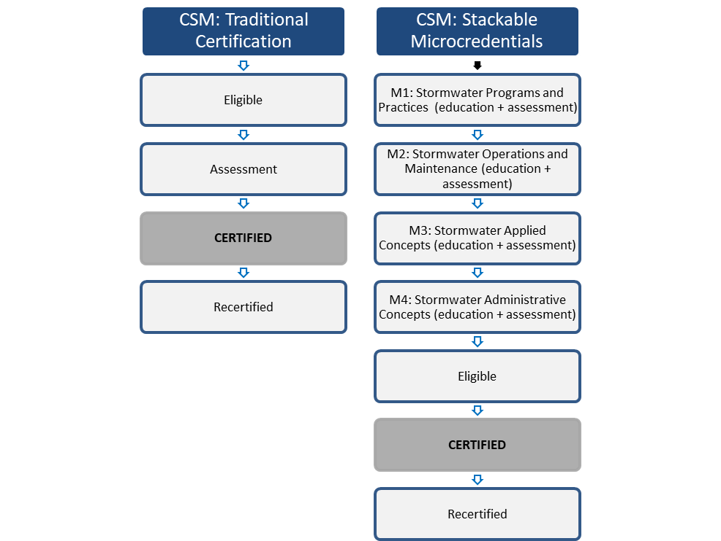
What are Microcredentials?
Notes:
In a traditional certification model, candidates must first meet defined eligibility requirements. Once eligible, they complete a comprehensive assessment, typically a proctored exam with anywhere from 120 to 150 questions.
Successfully passing that assessment results in earning the certification, followed by a rolling five‑year maintenance or recertification period. It’s important to note that in the traditional model, there is no built‑in education component, candidates are responsible for preparing on their own before taking the exam.
Microcredentials take a different approach. Instead of assessing a broad body of knowledge all at once, the content is broken down into smaller, focused topic areas. Each of these bite‑sized topics is paired with targeted education, followed by a short assessment. When completed, the learner earns a digital badge or microcredential.
These microcredentials can stand on their own, or they can be stacked together over time toward a larger certification. Once all required microcredentials are completed, that is when the individual applies for certification eligibility.
Eligibility requirements still exist, and candidates must still meet them to become certified. Once certified, the recertification and maintenance period remains the same as it is in our traditional certification programs.
The difference with microcredentials is the education is paired with the assessment, and order of the process, the education and assessment come first, and eligibility is evaluated at the end.”

Slide 11
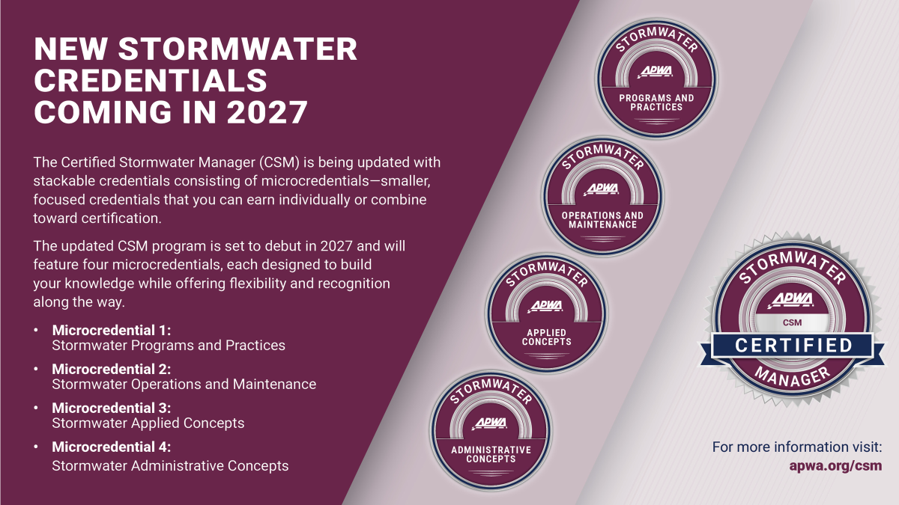
Notes:
Here is an example of the microcredential structure, based on the new sormwater microcredentials.

Slide 12
Microcredential Benefits
Engage Members
Strengthen Programming
Strengthen Leadership
Notes:
Engage Members
Microcredentials offer flexible, skill‑focused learning that makes it easier for members to stay involved. They create more frequent touchpoints for recognition and participation, helping members remain connected to the chapter between major events and certifications.
Strengthen Programming
Microcredential topics can guide chapter education by informing workshops, conference sessions, and peer‑learning opportunities. This helps ensure chapter programming stays relevant, practical, and aligned with current workforce and agency needs.
Strengthen Leadership
By supporting members as they build targeted skills, microcredentials help chapters develop a stronger pipeline of speakers, volunteers, and future leaders. Members gain confidence and credibility, which encourages greater involvement in chapter leadership and service.

Slide 13

APWA Accreditation Overview
The program will celebrate 30 years in 2028.
Currently, 227 accredited agencies across 179 organizations and 106 applicant agencies.

Slide 14
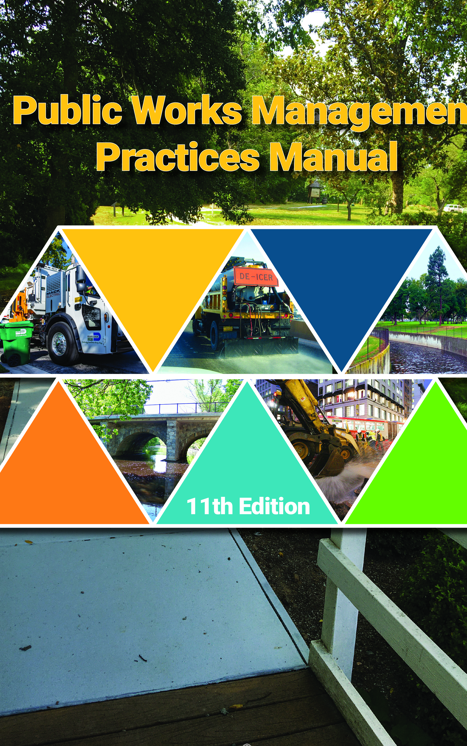
APWA Accreditation Overview
A voluntary program that recognizes public works agencies for meeting established management practices.
Through a structured evaluation and review process, agencies can objectively self-assess their operations and demonstrate compliance with the standards outlined in the Public Works Management Practices Manual.
Notes:
Manual is available in APWA store. If your chapter keeps a library of resources, this would be a great addition.

Slide 15
Program Awareness
Recognize newly-accredited agencies at awards ceremonies
Provide Training
Host a workshop
Get Accredited
For more information accreditation@apwa.org
Support and Promote the Agencies
Ask a representative from an accredited agency to speak at your conference or meeting
Develop a peer group for agencies
Include an article from an accredited agency in newsletter or on website
Create networking opportunities for interested agencies
Add a session to your chapter’s education schedule

Slide 16
Why Accreditation Matters to Chapters
Engaged, accredited agencies strengthen the chapter
Catalyst for chapter growth, collaboration, and engagement through peer network
Stronger chapter through shared success stories and a leadership pipeline
Notes:
Certified members are a resource chapters can tap into.
If a chapter is planning an annual conference, a PWI, or a workshop, certified members are a natural place to look for presenters on specific topics.
These members can also contribute by writing articles, serving on committees, or helping guide technical discussions.
Certification helps chapters know who to turn to when expertise is needed.

Slide 17
Chapter Opportunities & How Chapters Can Support Accreditation
"Promote APWA Accreditation: Chapter Outreach Resources"

Slide 18
Contacts
Accreditation (accreditation@apwa.org)
Jeanette Klamm
Associate Director of Credentialing
(816) 595-5295
Nicole Shoemaker Wendy Springborn
Accreditation Manager Accreditation Manager
(816) 595-5294 (816) 595-5256
Certification (certification@apwa.org)
April Wardlow Liz Gill
Certification Manager Credentialing Associate
(816) 595-5298 (816) 595-5299

