Slide 1
Advocacy Starts with Chapters
Building a Stronger Voice for Public Works

Slide 2
Learning Objectives
Learn why engaging in public works advocacy through APWA’s chapter grassroots network is essential
Use APWA Government Affairs resources to support chapter advocacy activities and association policy initiatives
Connect with peers and APWA Government Affairs on key advocacy initiatives and increase public works storytelling
Notes:
Mark – 1min (1:03-1:04)

Slide 3
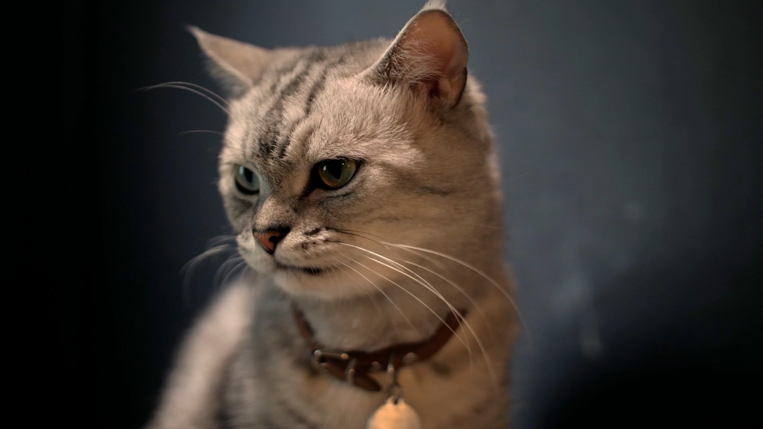
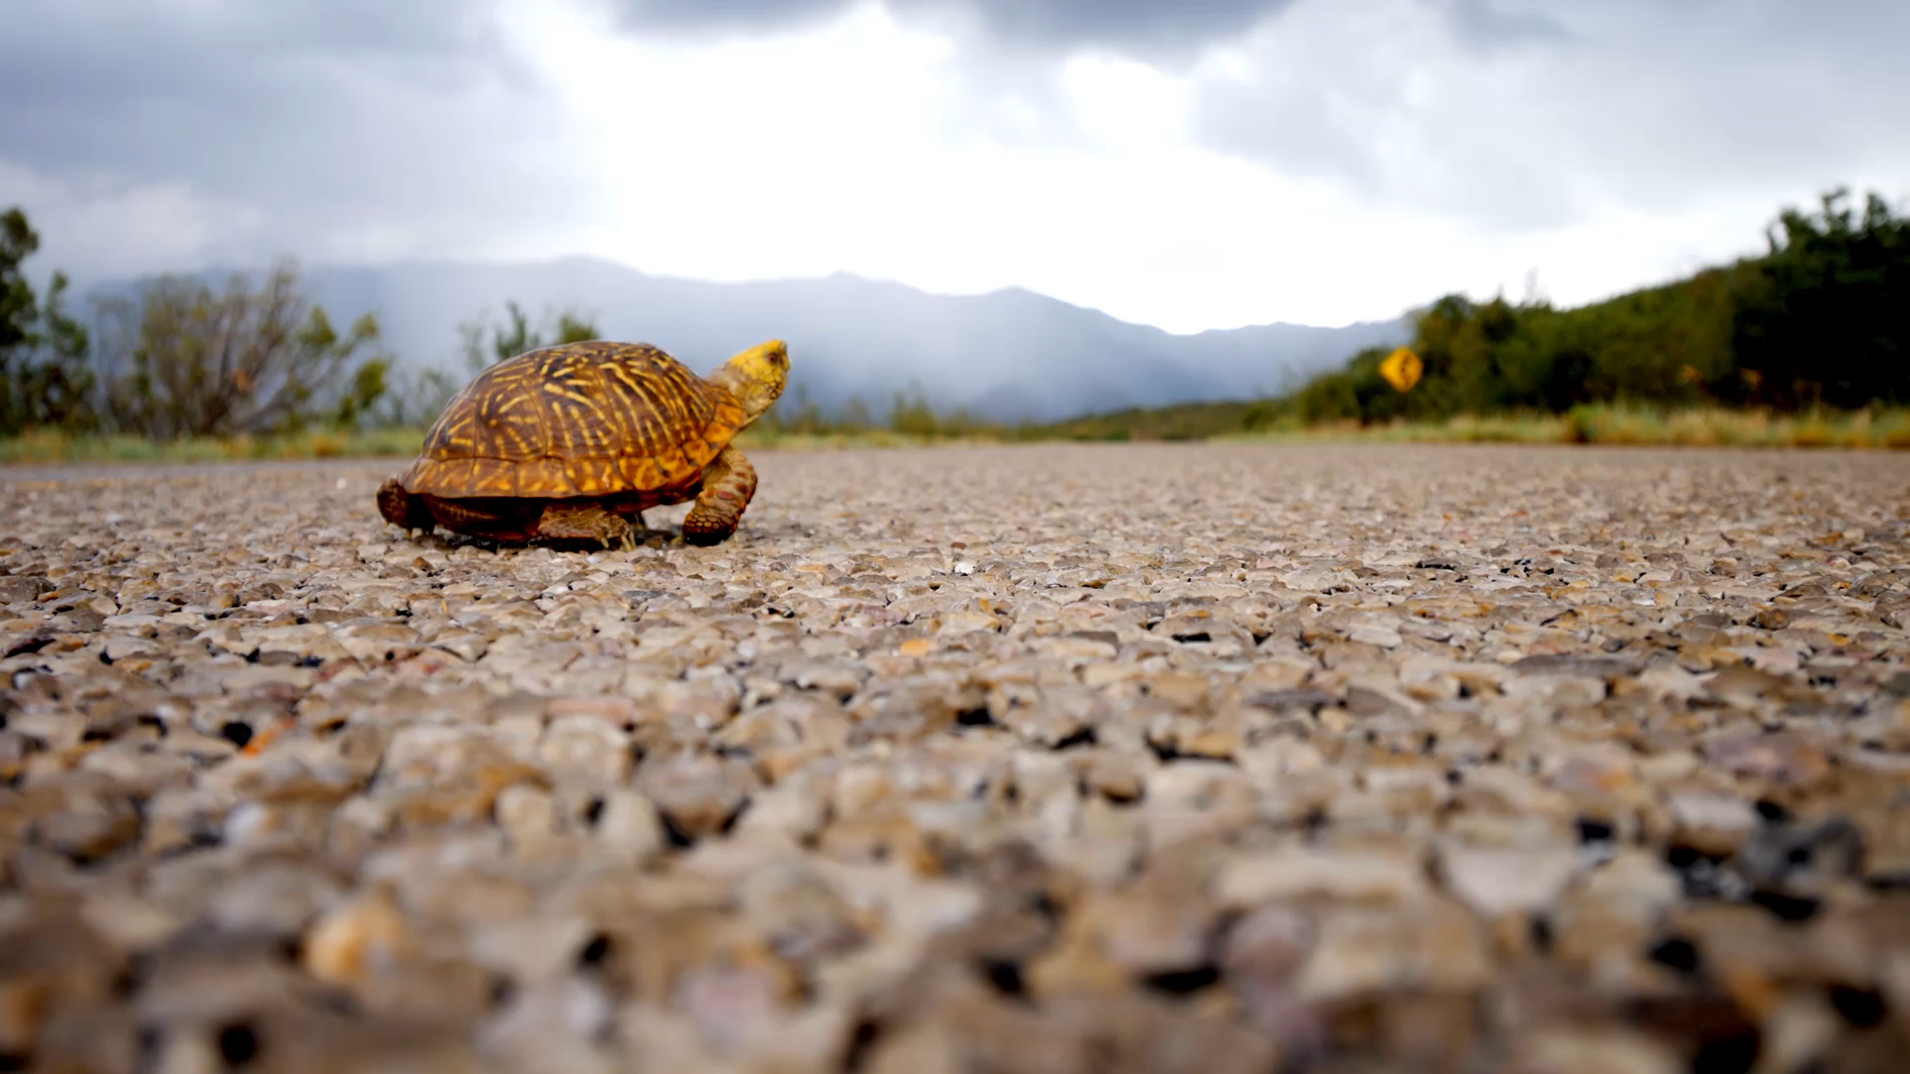
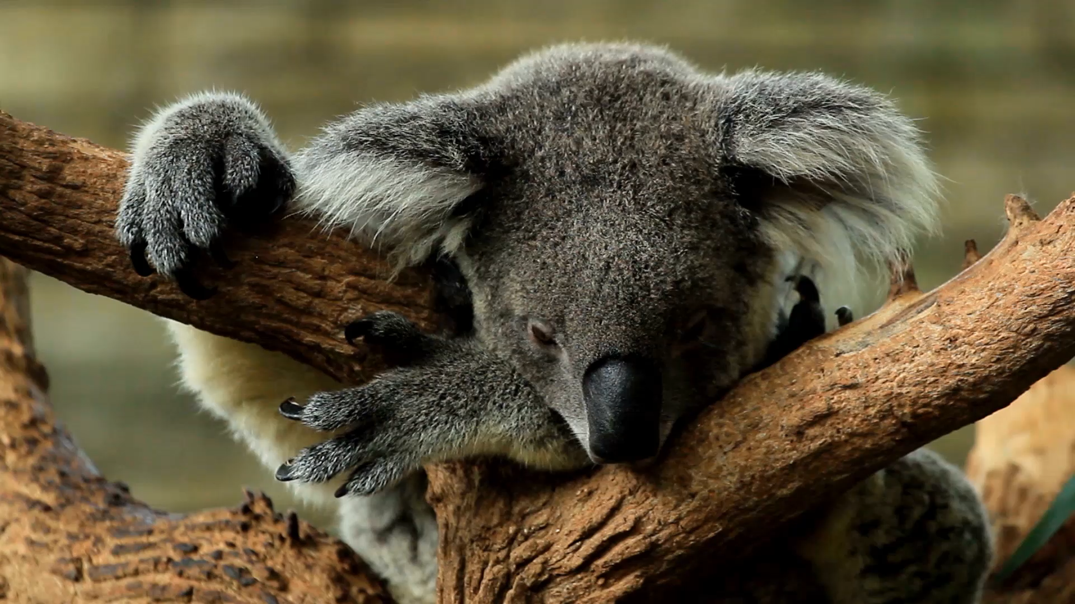
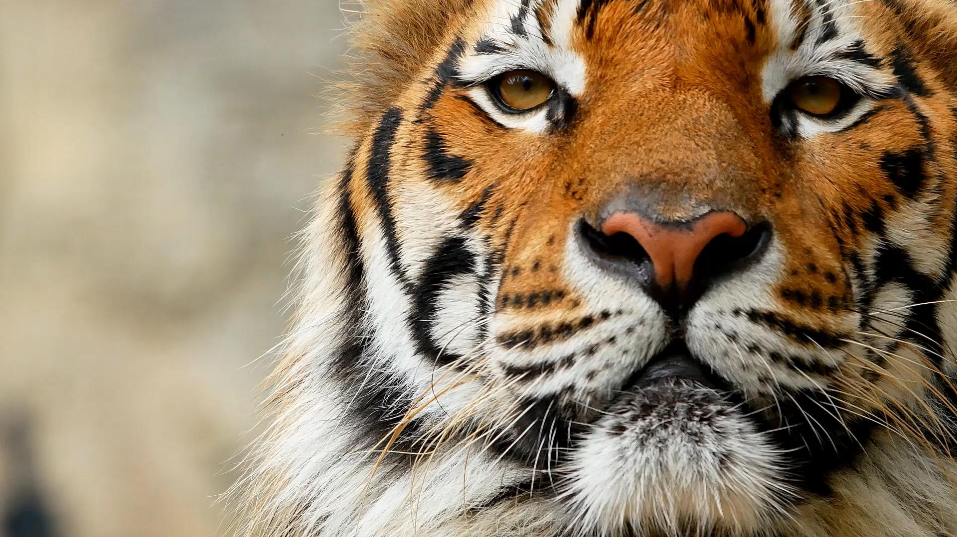

APWA Government Affairs
Dir. Government & Public Affairs Andrea Eales
Sr. Government Affairs Manager Marty Williams
Chief PowerPoint Designer Mark Shade
Government Affairs Manager
Leah Harnish
Government Affairs Specialist
Jeff Finegan
Notes:
Mark – 1min (1:04-1:05)

Slide 4

Notes:
Mark – 3min (1:05-1:08)

Slide 5




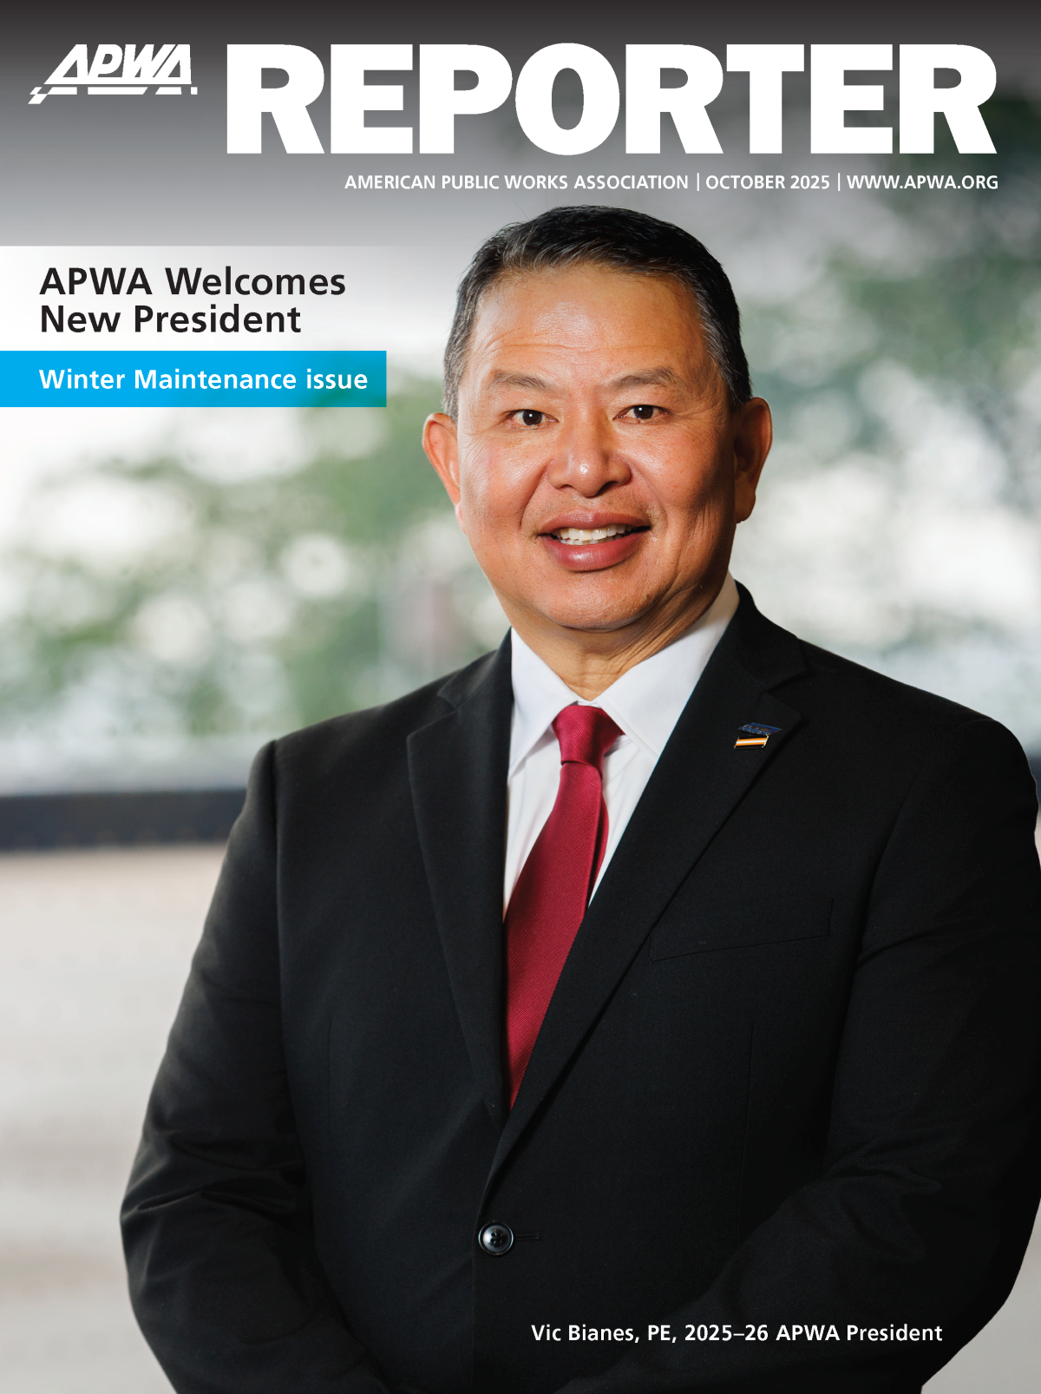
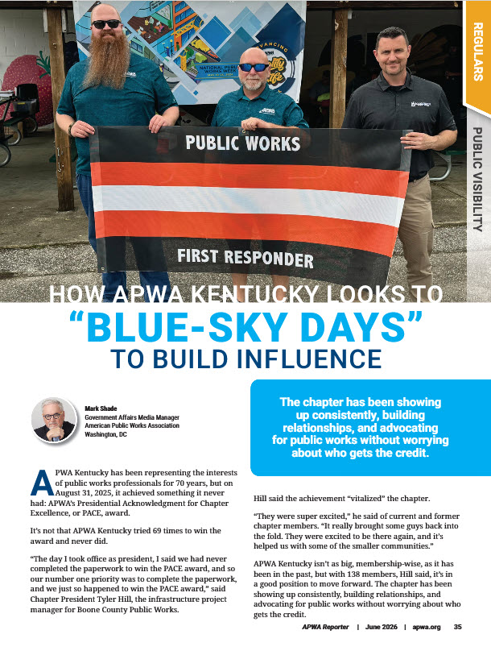
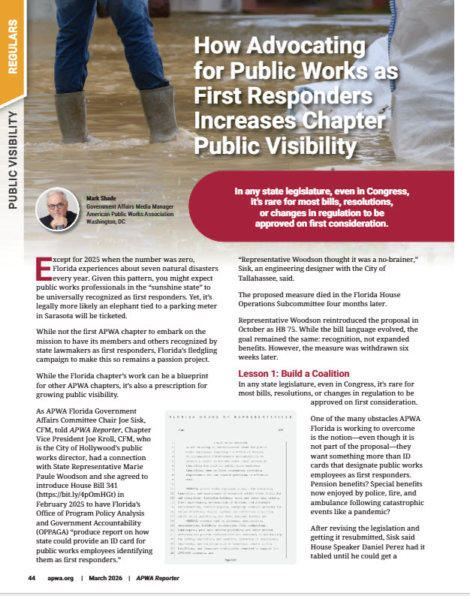
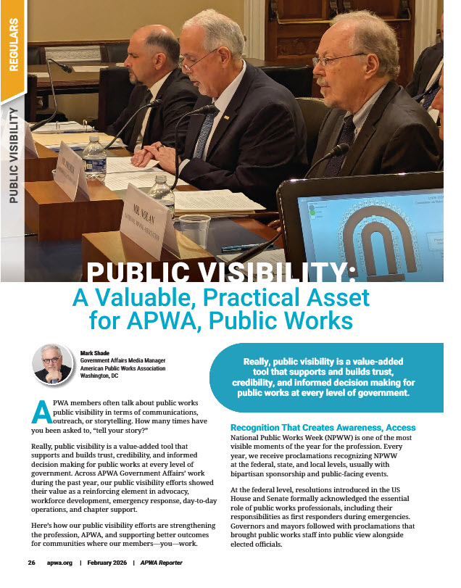
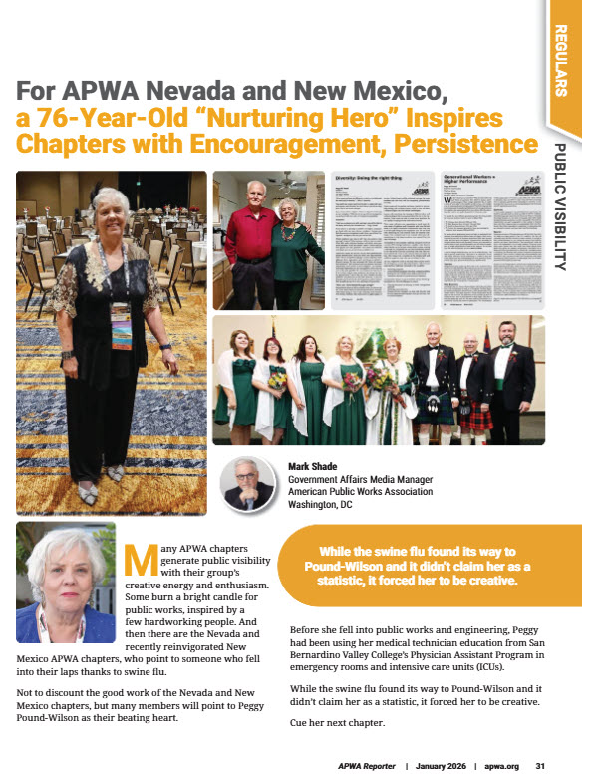
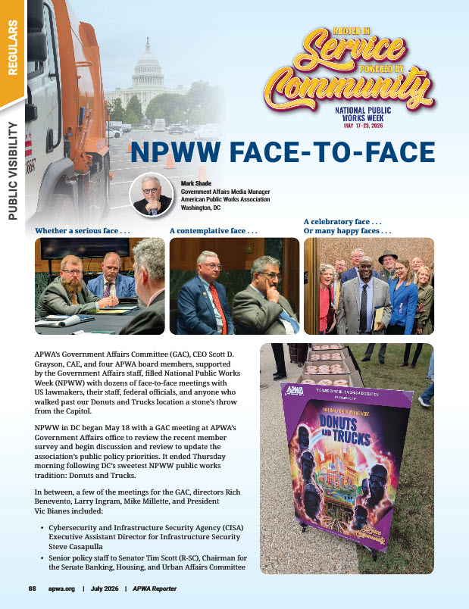
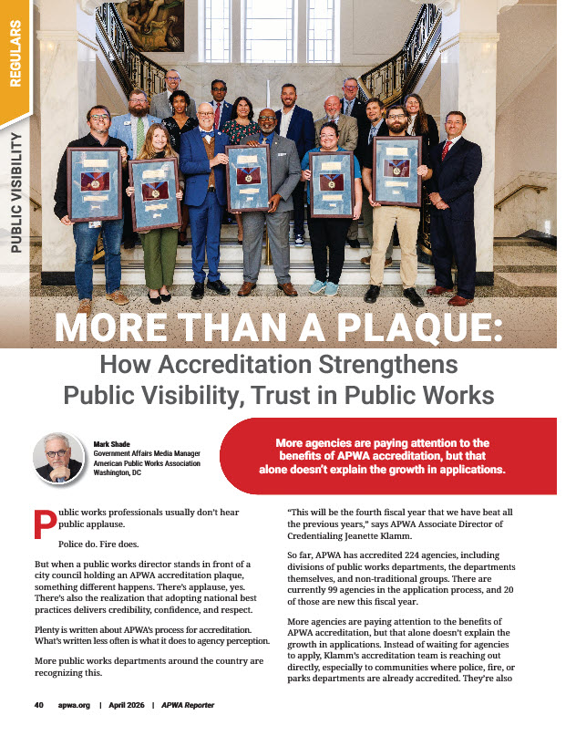
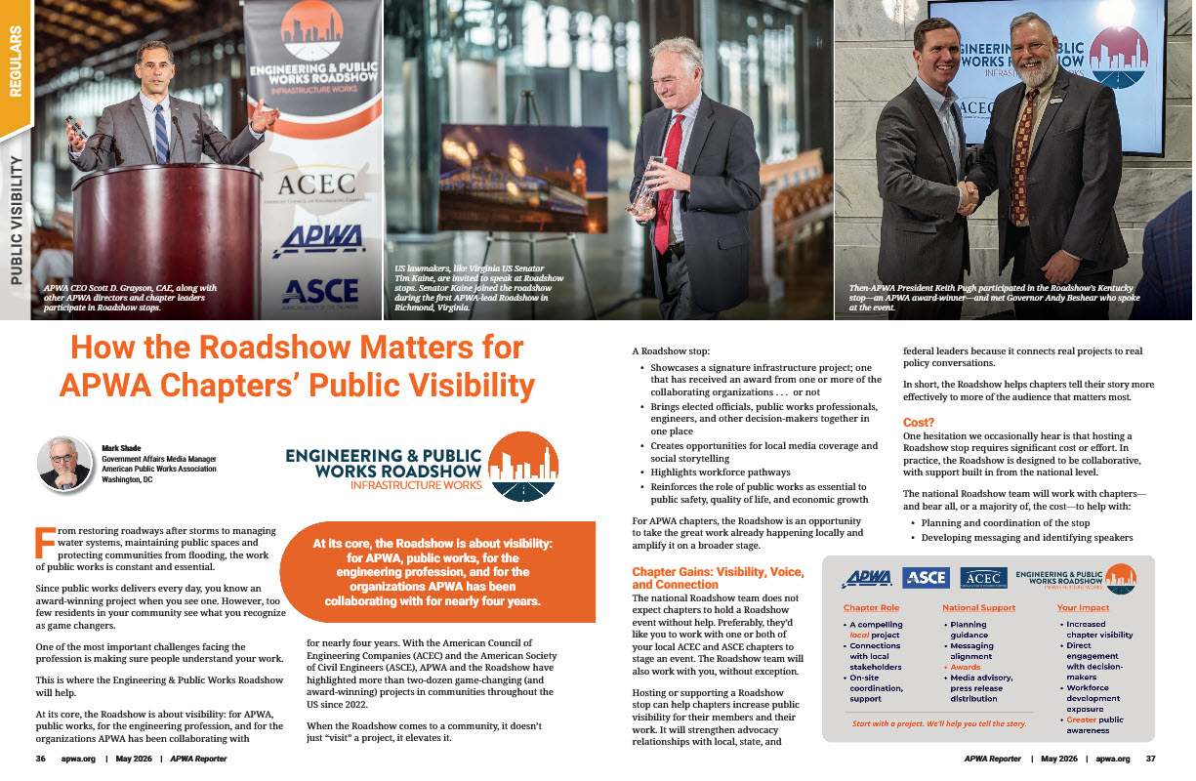
How We Partner with Chapters Today
Social media
Notes:
Mark – 2min (1:08-1:10)

Slide 6
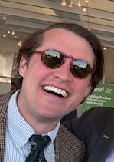



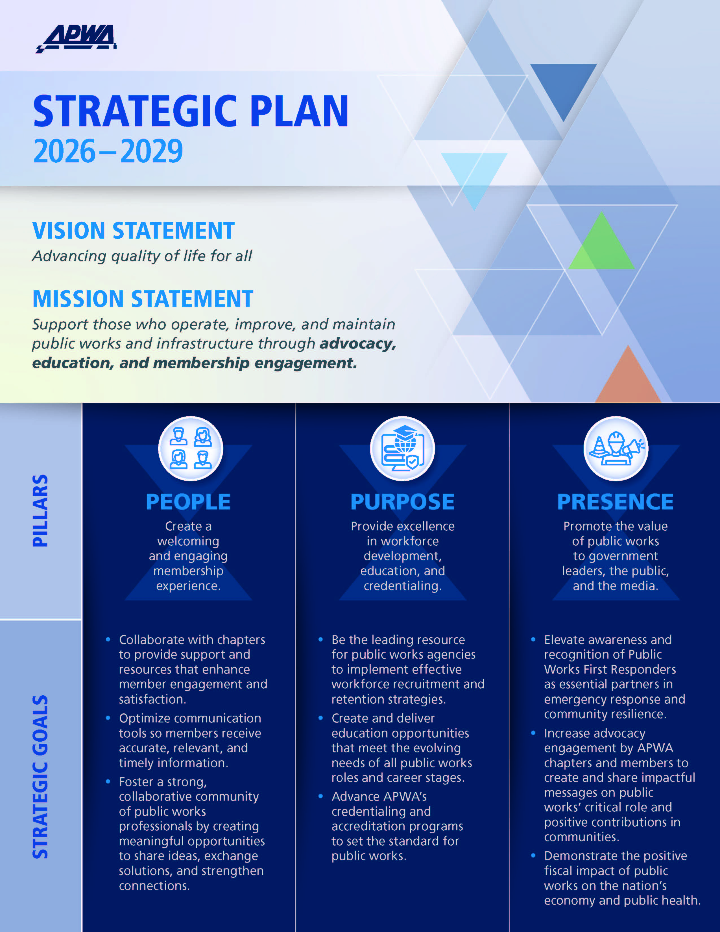

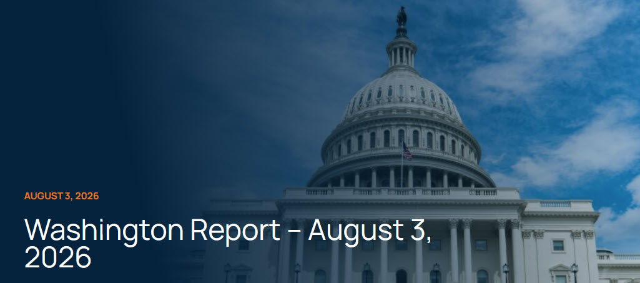
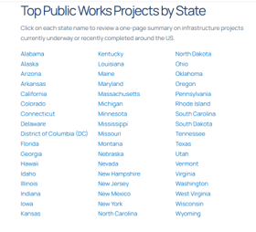

Our Tools = Your Tools
https://www.apwa.org/government-affairs/legislative-action-center/
Notes:
Jeff – 3min (1:10-1:13)
https://www.apwa.org/government-affairs/legislative-action-center/

Slide 7
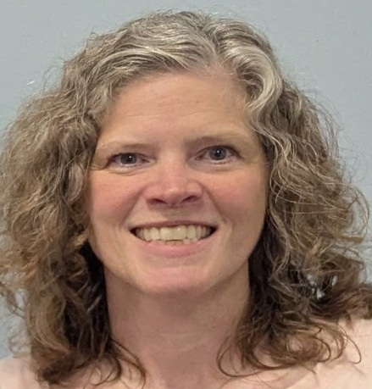
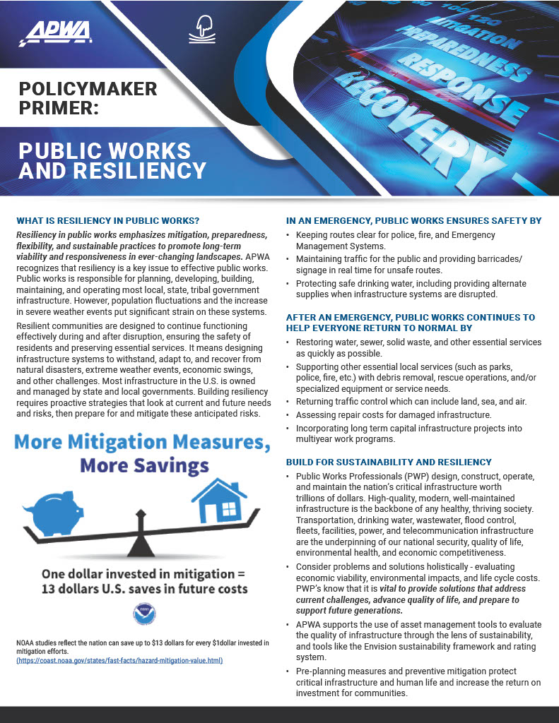
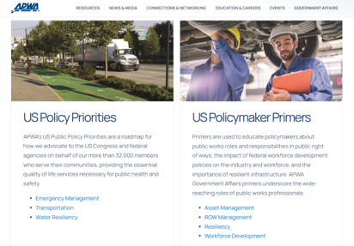

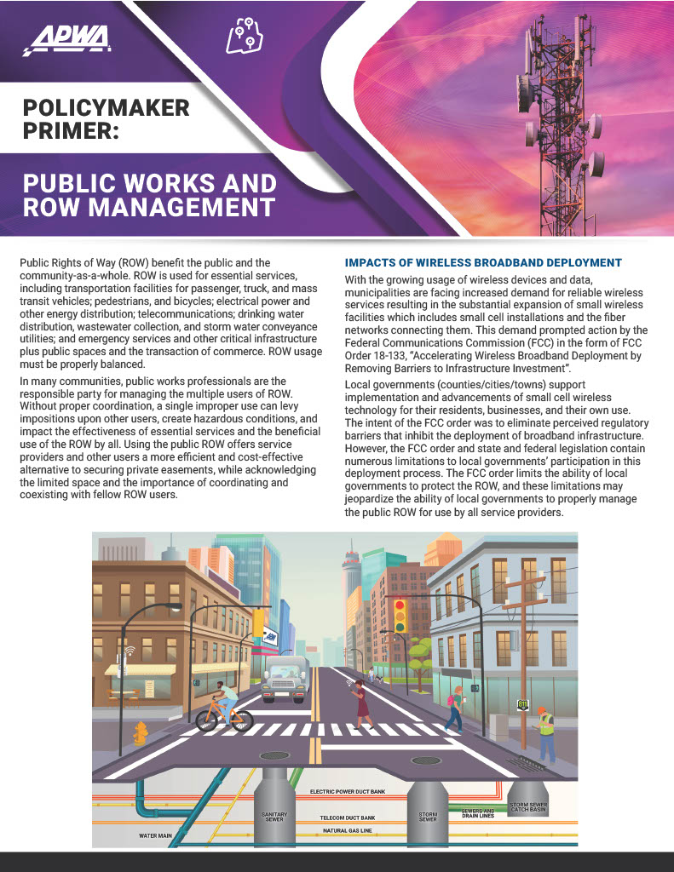

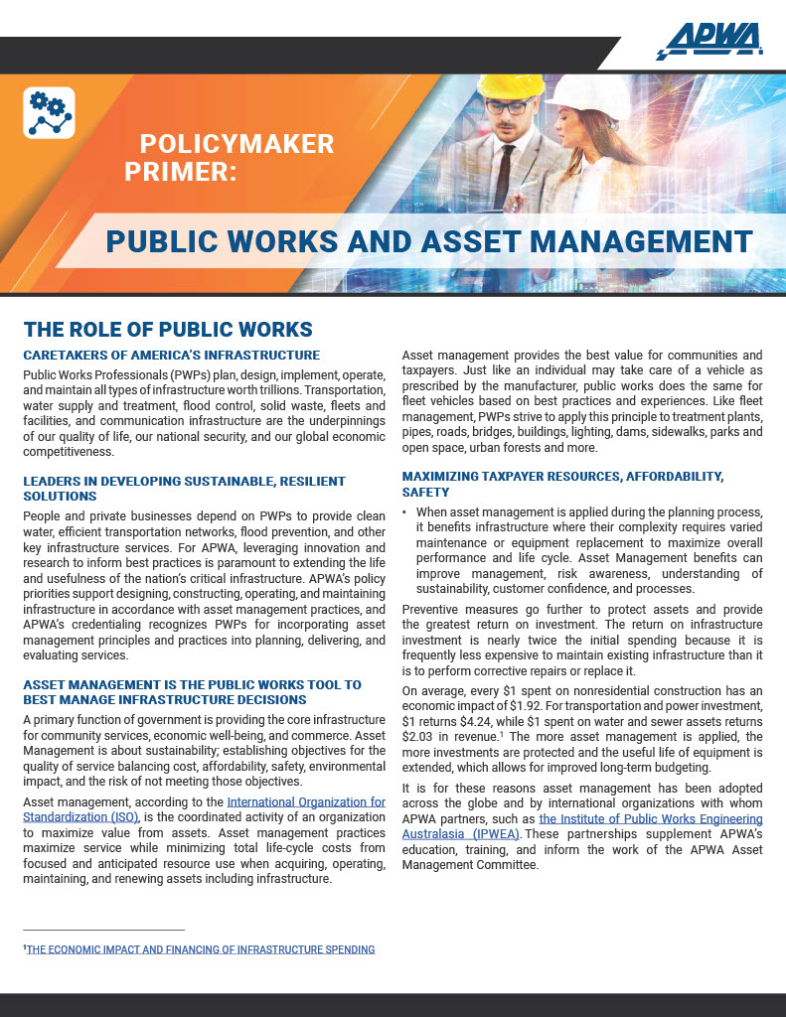

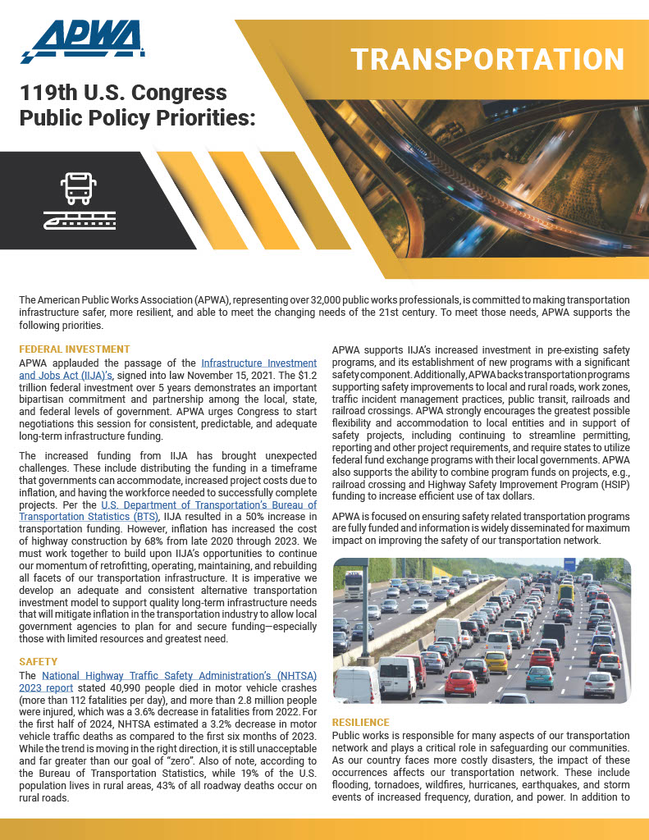
Our Tools = Your Tools
Notes:
Andrea-5 minutes (1:13-1:18)

Slide 8
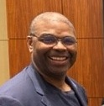


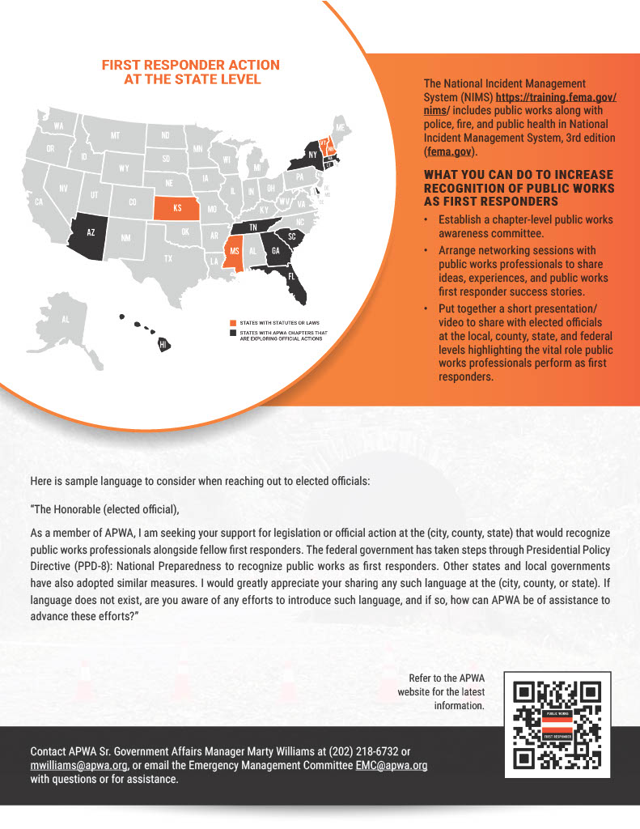
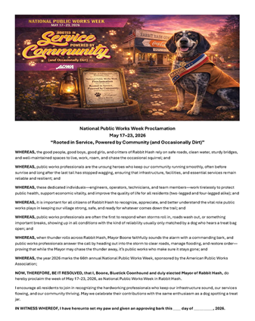
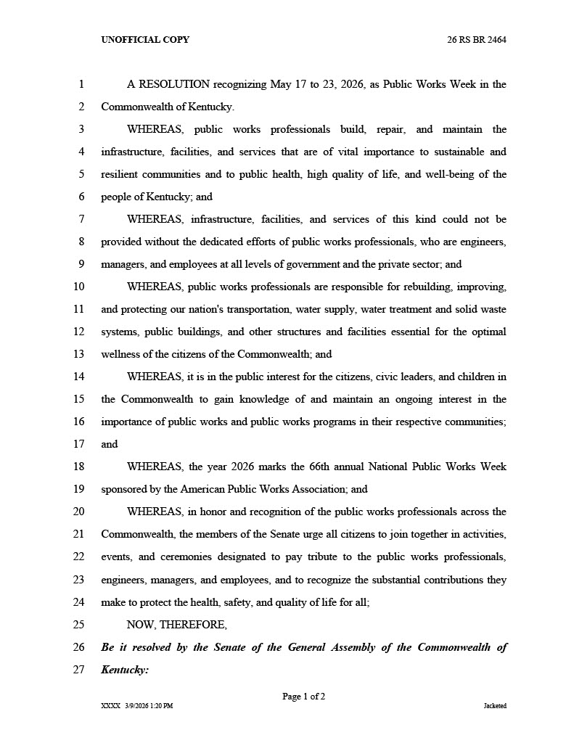
Our Tools = Your Tools
Notes:
Marty 2min (1:18-1:20)

Slide 9

Our Tools = Your Tools
https://www.apwa.org/resource/advocacy-ambassadors
Notes:
Marty 3min (1:20-1:23)

Slide 10
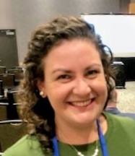
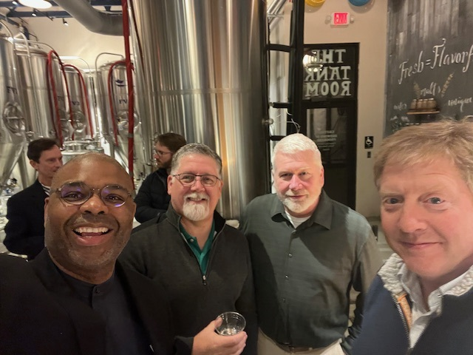
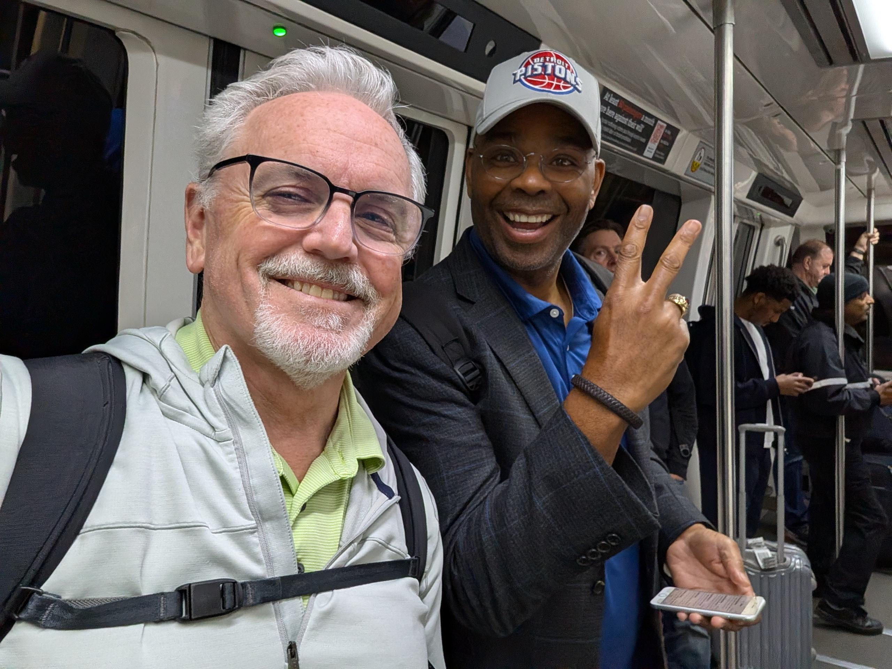
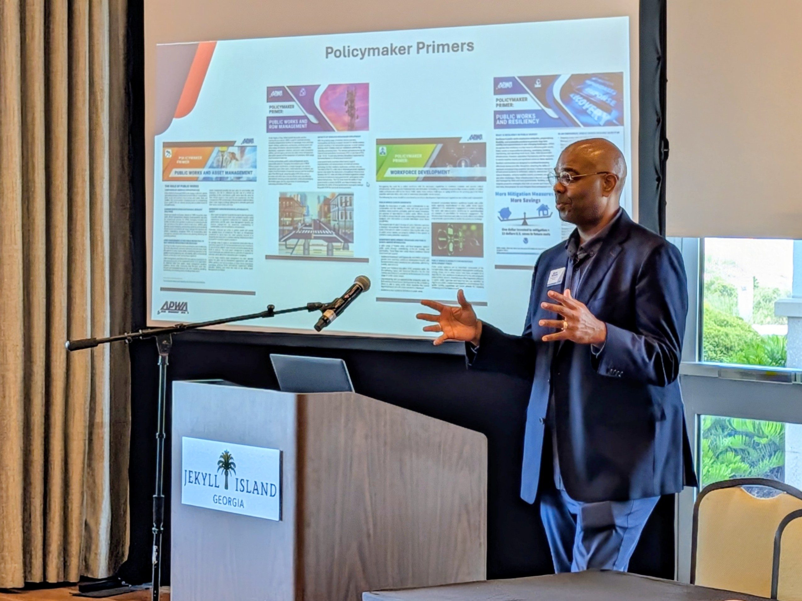
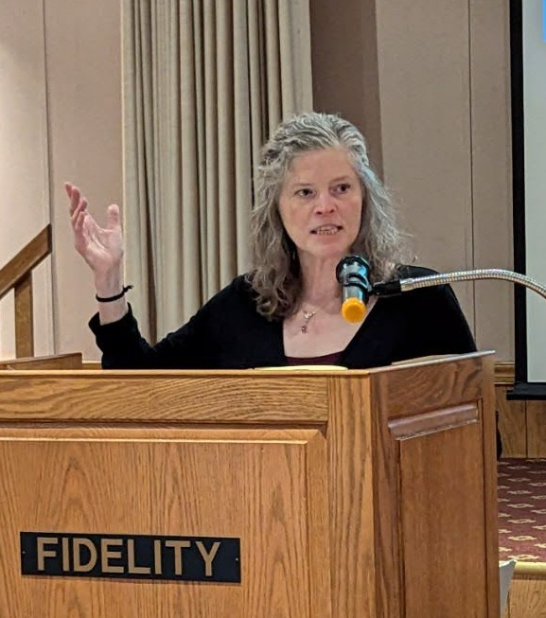
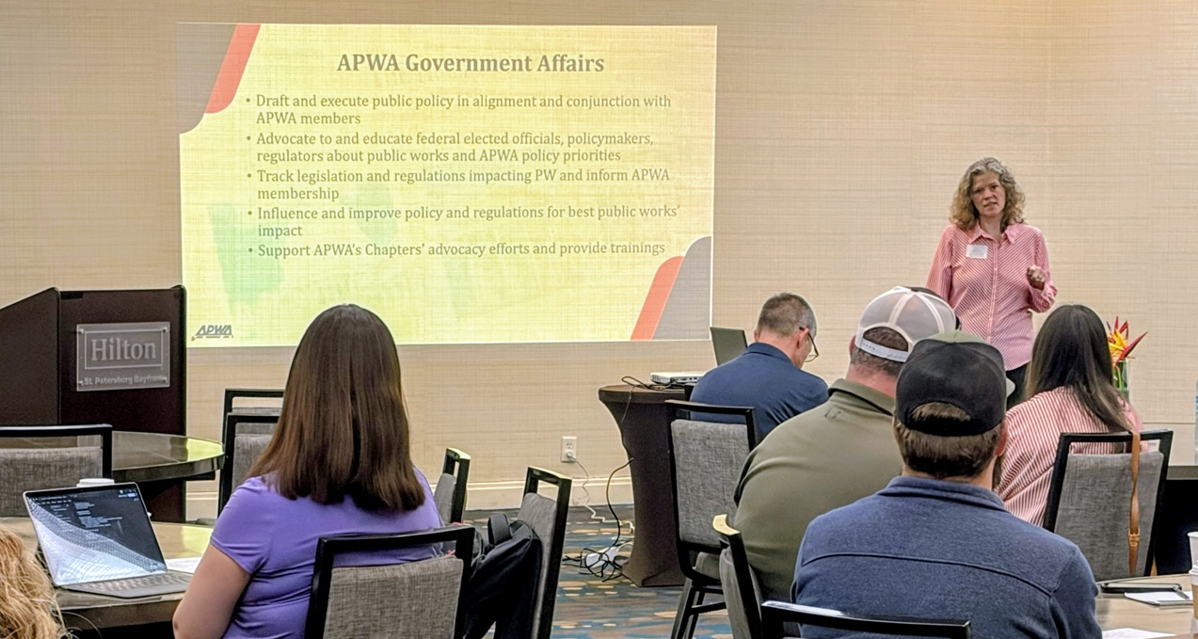
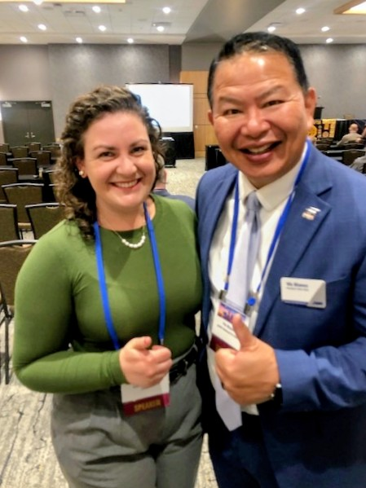
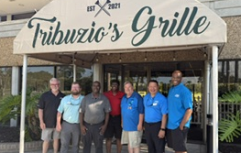
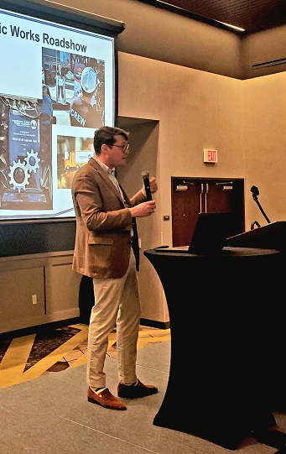
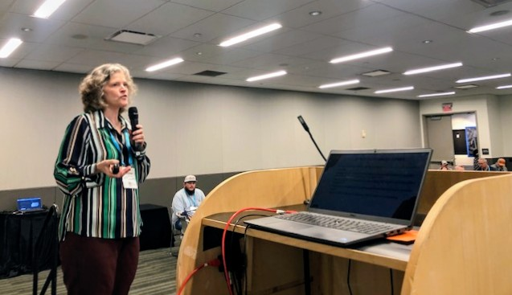
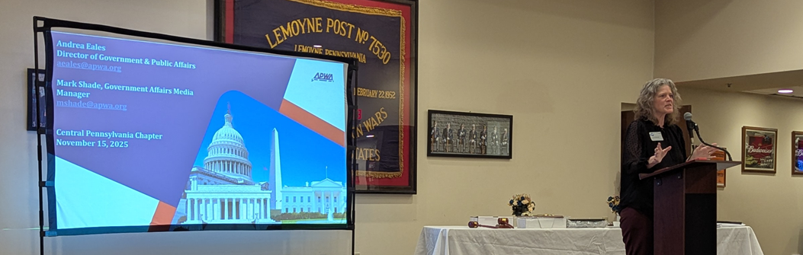
APWA GA Travels
Notes:
Leah 2min (1:23-1:25)

Slide 11
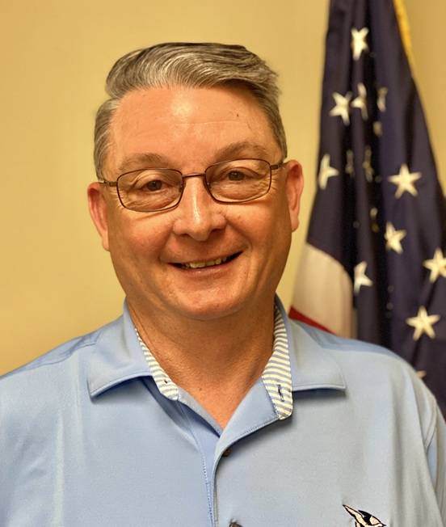
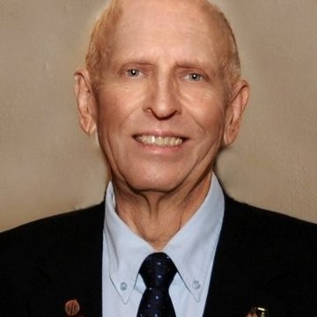
Special Guests
Jim Phipps, PE APWA Central PA
Chuck Denson
APWA South Carolina
Notes:
Leah – Tee up and let them go (5min each; 1:25-1:37)
We will now here from two very special guests, Jim Phipps, an Advocacy Ambassador with the Central Pennsylvania Chapter to share his experience as an ambassador, followed by Chuck Denson of Goose Creek, South Carolina, who serves as a member of the GAC, as well as the South Carolina chapter’s ambassador Chuck will talk about the role of public works professionals as first responders

Slide 12
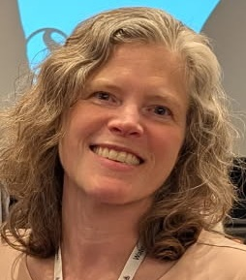
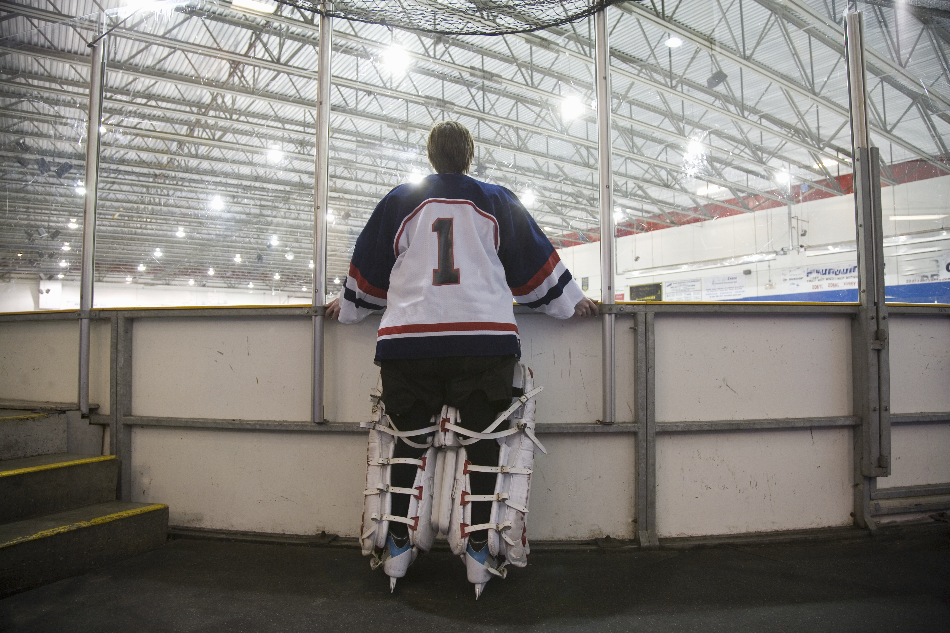


3X to Join Us at PWX
Aug. 31 @ 8a: Annual Legislative Update
Aug. 31 @ 4p: GAC Happy Hour Jam
Sept. 1 @ 10a: Regulatory Roundup
Notes:
Leah (30sec) (1:37-1:38)

Slide 13
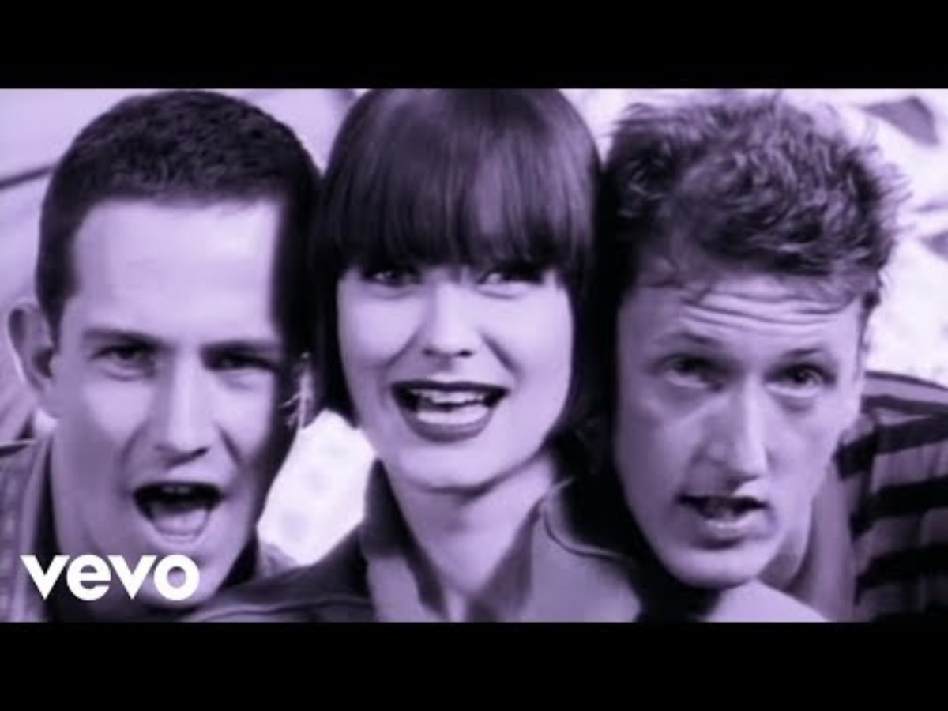
Time to …
Notes:
Leah cue (3min; 1:38-1:40) -
Break out to talk about (1:40-1:50)
What your chapter is doing advocacy wise
If you're not doing anything – why not?
Barriers to advocacy
Best practices/how to get people involved
10min in breakout

Slide 14
Jim/Chuck (10min)
Chuck – first responder engagement
Jim – engaging with elected officials

Slide 15
Breakout (10min)
Talk about and share what they're doing advocacy wise and what they're interested in doing
5 breakout rooms (goal – one of us per)
  7 min room
  3 min report out of what people are working on
  Jill/Alice will put a 1min warning before ends

Slide 16
What does GA do – special programs (10min)
How do we engage with members/empower chapters to be our grassroots advocate
  GAC/Policy priorities/policy resources (Andrea-5min)
  First responder program (Marty - 2min)
  Advocacy ambassador program (Marty - 3min)
  Chapter visits (Leah - 2min)
  Tee up Chuck/Jim (Leah – 30sec)

Slide 17

Notes:
Andrea (1:50-end)
4min – reporting from breakout (time permitting)
10min – Q&A

Slide 18
Agenda
1pm – 2pm
  Who is the GA team (5min)
  What do we do (15min)
    Pub affairs
    Policy areas we cover (come to PWX session for policy updates)
    Resources (Jeff)
  Special programs
    Tell your story
    Action alerts
    Attend chapter meetings
    Roadshows
    Advocacy ambassador program
  Chuck (First Responder) and Jim (Advocacy Ambassador program) speak (10min)

