Slide 1
Submitting an Award 101

Slide 2
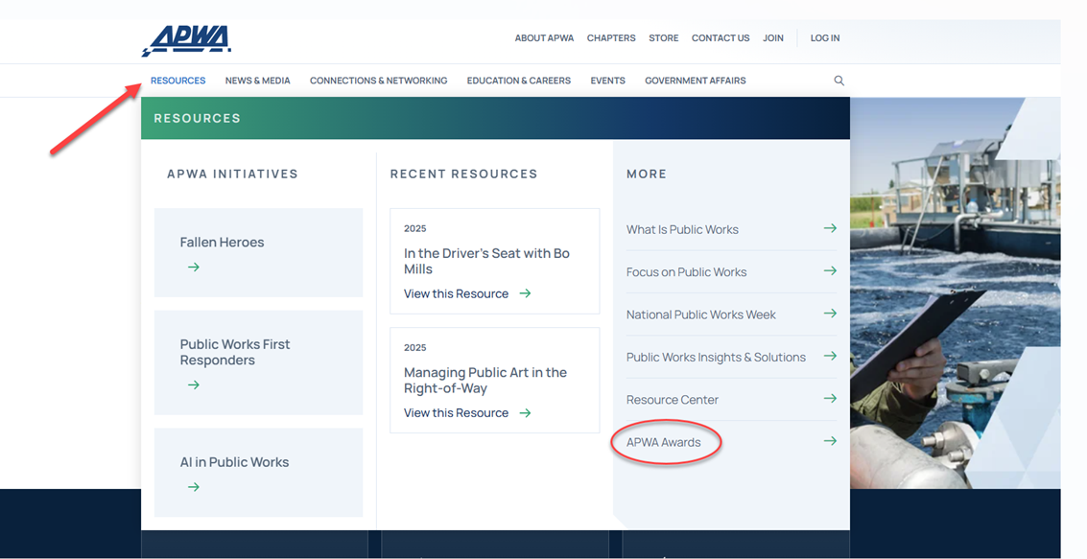
Where to Start?
First, you will want to go to the APWA homepage and hover over resources. Click on APWA Awards from the More menu.
Once on the APWA Awards landing page, you will see a list of awards from which you can select and submit a nomination.
Notes:
A two day live virtual education series designed to explore the themes of challenging the process and the need for adaptability in public works. The program will specifically focus on both technological innovation and human innovation can help public works professionals adapt to emerging challenges and drive meaningful change. This program will offer .4 Continuing Education Units (CEUs) and serve as a platform for both learning and dialogue.

Slide 3
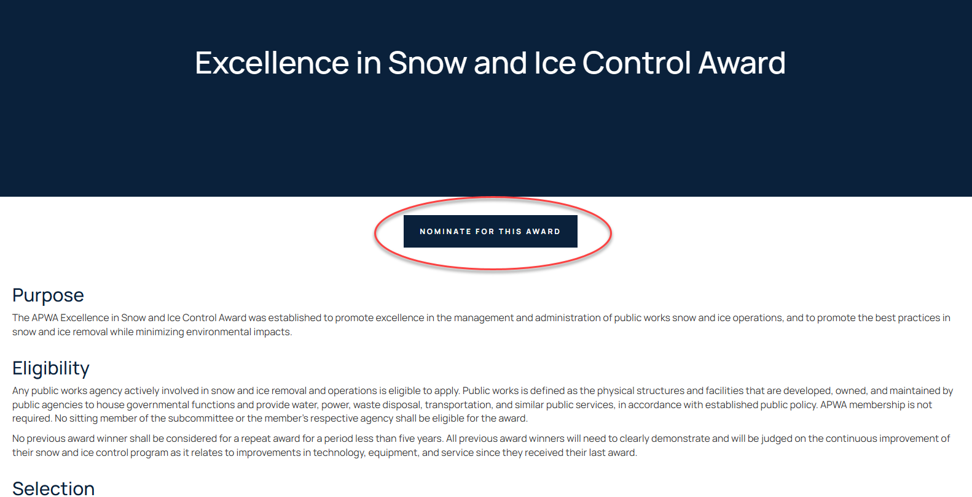
Award Landing Page
On the award landing page, you will find information on the award, such as criteria, deadline, and the nomination process.
To begin the nomination process, click on the blue button labeled “nominate for this award.
Notes:
A two day live virtual education series designed to explore the themes of challenging the process and the need for adaptability in public works. The program will specifically focus on both technological innovation and human innovation can help public works professionals adapt to emerging challenges and drive meaningful change. This program will offer .4 Continuing Education Units (CEUs) and serve as a platform for both learning and dialogue.

Slide 4
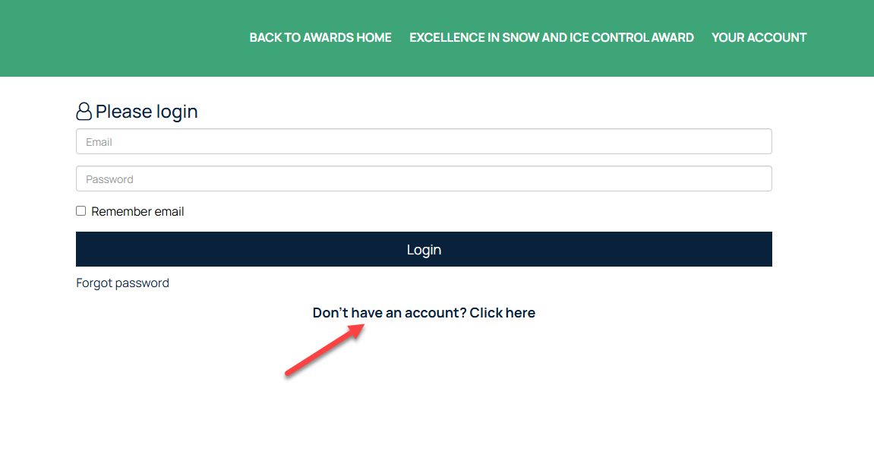
Login Page
To submit an award with our new software, Evessio, you’ll need to create an account. (This is separate from your APWA login.)
If this is your first time submitting an award, select “Don’t have an account” and follow the steps to set up your credentials.

Slide 5
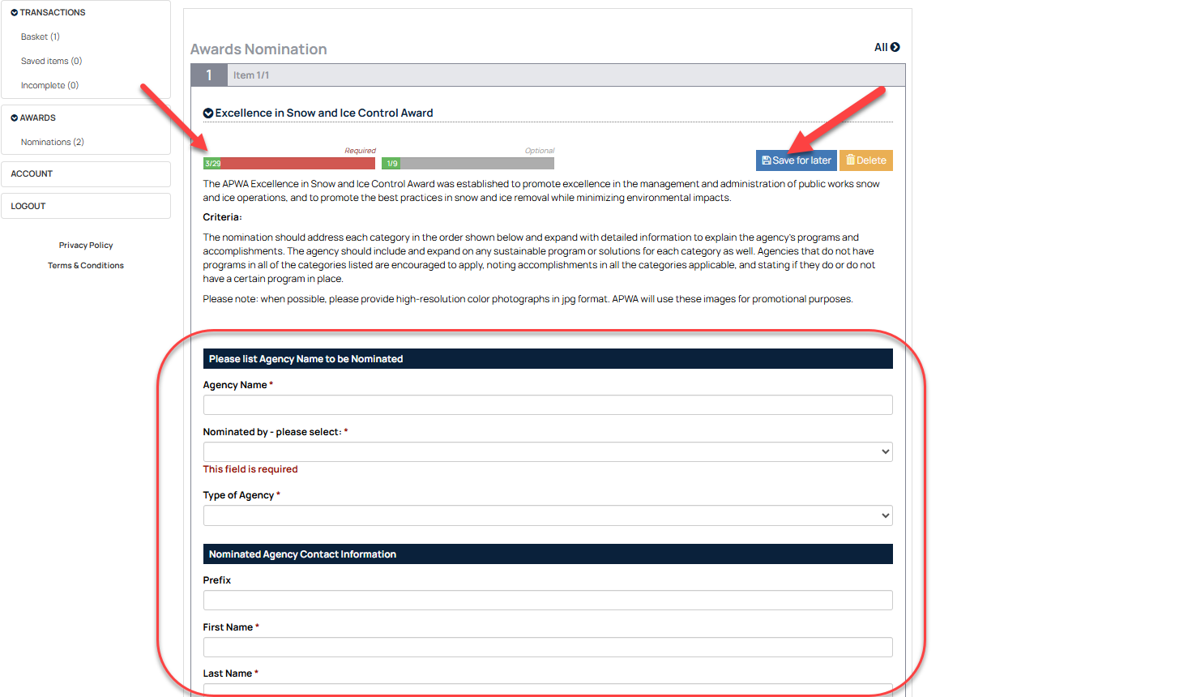
Award Nomination Page
Here is where you will enter all the information required for an award nomination.
The top left corner will show how many required fields need to be entered and how many you have already filled in. (This will carry over some of your information as the nominator.)
You can save your progress in the top right corner if you need to come back and finish the submission at a later time.

Slide 6
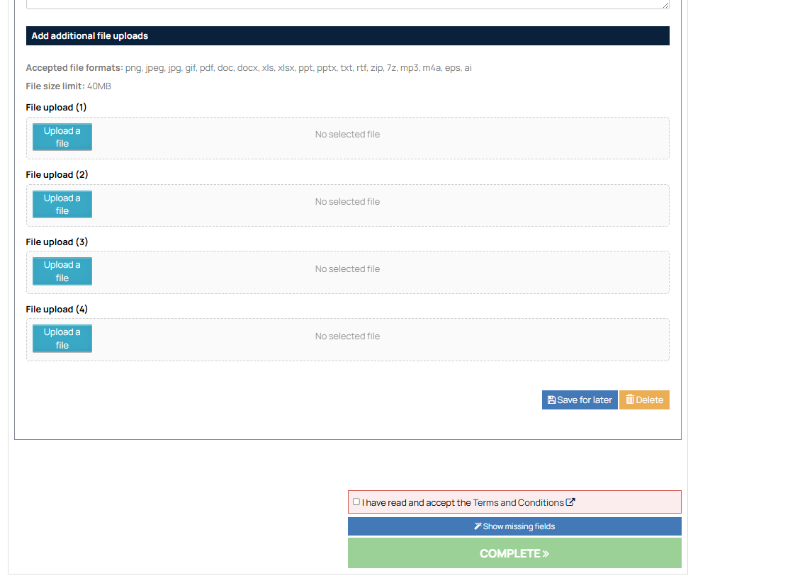
You can upload any files or supporting documentation for your submission.
Once you have finished uploading everything, you will need to click and accept the Terms and Conditions.
You can select the blue button under that to show any missing fields that you may have missed.
Once you are done, hit complete.

Slide 7
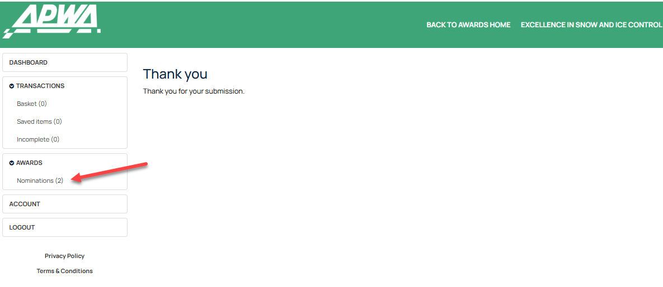
Upon completion of your award submission, you will receive an email confirmation along with a PDF of all the information you submitted.
Additionally, you can click on “Nominations” to see what you have submitted, along with any previous submissions you have made.

