Slide 1
COMMUNICATIONS 101
Building a chapter communications plan that drives growth and engagement
Notes:
Introduce the session as a practical planning workshop. Participants will leave with a reusable strategy framework, campaign worksheet and tool-selection criteria.
[Sources]
- Internal source: 23ChapterLeadersTraining_ChapterCommunications.pptx
[/Sources]

Slide 2
What you will be able to do
Three practical outcomes for chapter leaders and volunteers
1. Build a strategy
2. Plan a campaign
3. Choose tools wisely
Develop a month- or year-long plan using your chapter website, email, and social media to promote events, increase engagement, and strengthen visibility.
Define the audience, goal, key message, and coordinated channel activities for an event or membership campaign.
Evaluate free or low-cost tools that help create, schedule, distribute, and measure marketing more efficiently.
COMMUNICATIONS 101
Notes:
Review the objectives and ask participants to choose the one outcome that would have the biggest immediate impact in their chapter.
[Sources]
- Internal source: 23ChapterLeadersTraining_ChapterCommunications.pptx
[/Sources]

Slide 3
Communication is a chapter growth strategy
Every message should support a meaningful chapter outcome
SECTION 1
WHY COMMUNICATIONS MATTER
Membership
Attendance
Engagement
Visibility
Recruit • retain
Register • return
Volunteer • lead
Recognize • influence
The goal is not to communicate more. It is to make participation easier and chapter value more visible.
COMMUNICATIONS 101
Notes:
Connect each outcome to a real chapter priority. Emphasize that channels are tools, not goals.
[Sources]
- Internal source: 23ChapterLeadersTraining_ChapterCommunications.pptx
[/Sources]

Slide 4
Lead with member value
People respond when communications connect to a need
SECTION 1
WHY COMMUNICATIONS MATTER
Advance
Connect
Contribute
Career development
Technical learning
Leadership opportunities
Peer relationships
Mentors
Professional community
Volunteer service
Chapter leadership
Public works visibility
Message test
Does the message explain why this opportunity matters to the audience, not only when and where it happens?
COMMUNICATIONS 101
Notes:
Reframe the original reasons people join APWA as benefits that can guide headlines, subject lines and calls to action.
[Sources]
- Internal source: 23ChapterLeadersTraining_ChapterCommunications.pptx
[/Sources]

Slide 5
From random activity to a repeatable system
A simple planning discipline reduces last-minute work
SECTION 1
WHY COMMUNICATIONS MATTER
Reactive communications
Strategic communications
Last-minute requests
One message for everyone
Channel-by-channel decisions
Inconsistent timing
Success defined as “we posted it”
Shared calendar
Defined audience and action
Coordinated channel roles
Planned campaign rhythm
Results used to improve
COMMUNICATIONS 101
Notes:
Invite participants to identify one reactive habit their chapter can replace with a repeatable practice.
[Sources]
- Internal source: 23ChapterLeadersTraining_ChapterCommunications.pptx
[/Sources]

Slide 6
The chapter communications framework
Three channels, one coordinated strategy
SECTION 2
BUILD YOUR STRATEGY
Website
Email
Social media
The source of truth. Publish complete, current information and make the next action easy.
The direct connection. Target messages, build urgency, and follow up with specific audiences.
The visibility engine. Show the chapter experience, extend reach, and invite sharing.
Use all three channels to reinforce one goal and one core message.
COMMUNICATIONS 101
Notes:
Modernize the original Big 3 concept. Explain that each channel performs a different job within the same campaign.
[Sources]
- Internal source: 23ChapterLeadersTraining_ChapterCommunications.pptx
[/Sources]

Slide 7
Start with the annual communications calendar
Map known priorities before filling individual posts
SECTION 2
BUILD YOUR STRATEGY
Q1 | Renewal + planning
Q2 | Visibility + community
Q3 | Events + connection
Q4 | Recognition + transition
Membership value
Leadership priorities
NPWW
Awards
Spring programs
Conferences
Technical programs
Awards
Elections
Volunteer recruitment
Add confirmed dates, recurring deadlines, and national campaigns first.
Then identify communication gaps.
COMMUNICATIONS 101
Notes:
Use this slide to demonstrate a top-down planning approach. The examples are suggested planning categories and should be adapted by each chapter.
[Sources]
- Internal source: 23ChapterLeadersTraining_ChapterCommunications.pptx
[/Sources]

Slide 8
Turn the annual plan into a monthly rhythm
Consistency is easier when content has a repeatable structure
SECTION 2
BUILD YOUR STRATEGY
WEEK 1
What is coming up?
Event or deadline
WEEK 2
Who is involved?
Member or volunteer story
WEEK 3
What can members use?
Resource or learning
WEEK 4
What action is next?
Register, renew, or volunteer
Tip: Plan the message once, then adapt it to each channel.
COMMUNICATIONS 101
Notes:
Encourage a realistic cadence. Chapters do not need daily content to communicate consistently.
[Sources]
- Internal source: 23ChapterLeadersTraining_ChapterCommunications.pptx
[/Sources]

Slide 9
One message, three channel roles
Coordinate the experience instead of copying the same content everywhere
SECTION 2
BUILD YOUR STRATEGY
Website: complete
Email: persuade
Social: show
Registration page
Program details
Speaker information
Location and accessibility
Primary call to action
Audience-specific benefit
Timely reminder
Deadline or reason to act
Direct registration link
Speaker or member stories
Visual previews
Shareable reminders
Live and post-event moments
COMMUNICATIONS 101
Notes:
Use a chapter event as the example. The website holds complete information, email drives action and social media creates visibility.
[Sources]
- Internal source: 23ChapterLeadersTraining_ChapterCommunications.pptx
[/Sources]

Slide 10
Your website is the digital headquarters
Every campaign needs one reliable destination
SECTION 3
WEBSITE ESSENTIALS
Keep dates, event details, and registration information current.
Use clear headlines that emphasize the benefit.
Make the primary action visible without searching.
Write for mobile scanning: short sections and clear section labels.
Post photos that show authentic chapter activities and members.
5-SECOND TEST
Can a visitor quickly tell:
• What is happening?
• Why it matters?
• What to do next?
COMMUNICATIONS 101
Notes:
Ask participants to think about the last time they visited their own chapter website as a first-time visitor.
[Sources]
- Internal source: 23ChapterLeadersTraining_ChapterCommunications.pptx
[/Sources]

Slide 11
Website content checklist
Prioritize the pages that help people participate
SECTION 3
WEBSITE ESSENTIALS
✓
Upcoming events are easy to find
✓
Registration links are current
✓
Membership value and next steps are clear
✓
Leadership and contact information are accurate
✓
Volunteer opportunities are visible
✓
Photos and news show recent chapter activity
COMMUNICATIONS 101
Notes:
This checklist can become a quarterly website review. Assign each item to a chapter role and document the update date.
[Sources]
- Internal source: 23ChapterLeadersTraining_ChapterCommunications.pptx
[/Sources]

Slide 12
Choose website content by user need
Not every item deserves equal prominence
SECTION 3
WEBSITE ESSENTIALS
Join or renew
Attend
Get involved
Membership benefits
How to join
Local chapter value
Member contacts
Upcoming opportunities
Program outcomes
Registration details
What to expect
Volunteer openings
Committee contacts
Leadership pathways
Recognition opportunities
COMMUNICATIONS 101
Notes:
Organize content around what visitors want to accomplish rather than the chapter’s internal structure.
[Sources]
- Internal source: 23ChapterLeadersTraining_ChapterCommunications.pptx
[/Sources]

Slide 13
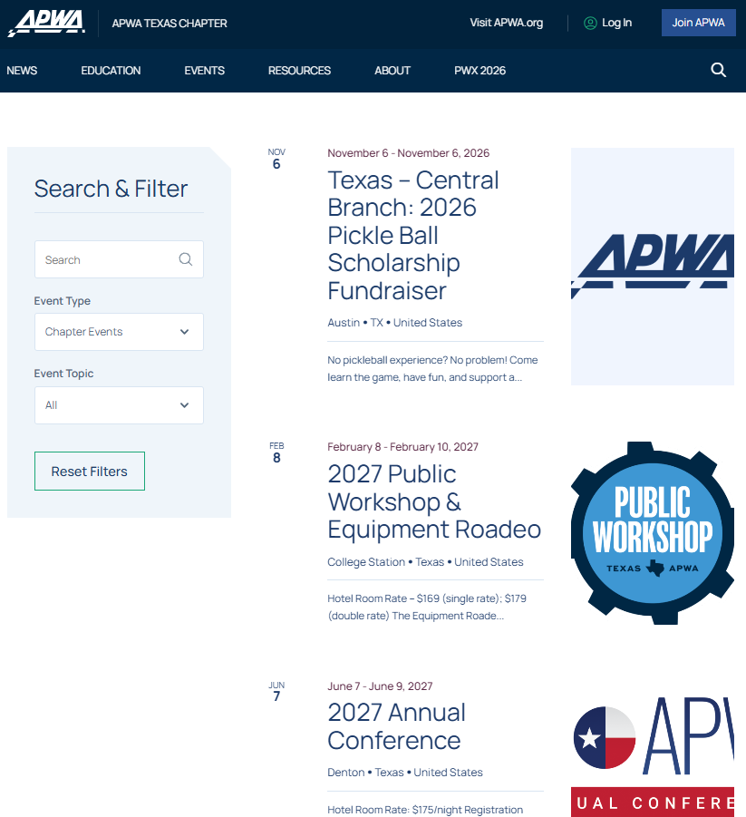
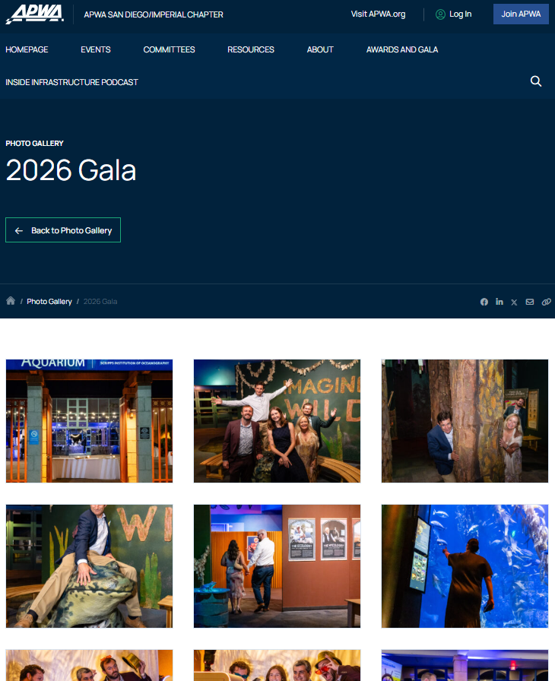

Slide 14
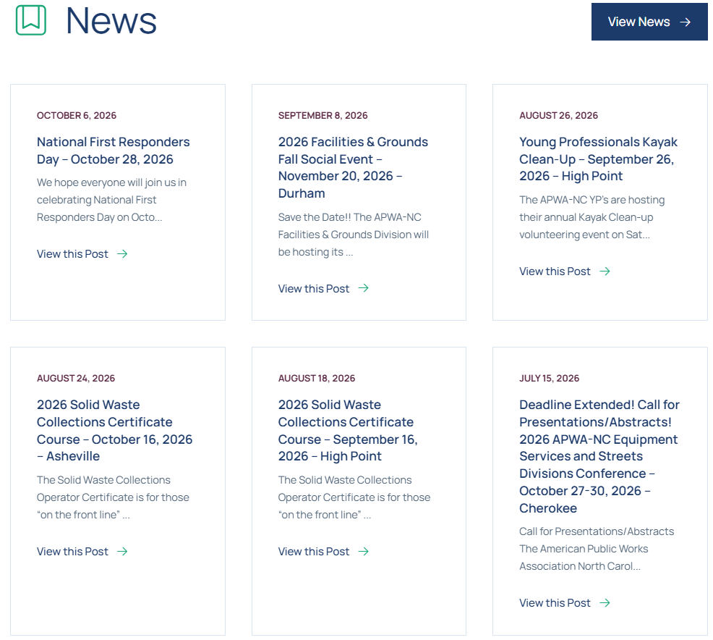

Slide 15
Why email still matters
Email helps chapters reach known audiences directly
SECTION 4
EMAIL MARKETING
PROMOTE
NURTURE
ACTIVATE
Events and deadlines
Member relationships
Volunteers and leaders
A strong email answers three questions
Why should I care?
What do I need to know?
What should I do next?
COMMUNICATIONS 101
Notes:
The original deck identifies email as a core chapter channel. This slide reframes email around the jobs it performs.
[Sources]
- Internal source: 23ChapterLeadersTraining_ChapterCommunications.pptx
[/Sources]

Slide 16
An effective email has one clear path
Make the most important action easy to see
SECTION 4
EMAIL MARKETING
1
SUBJECT
Create a reason to open
2
HEADLINE
Lead with the benefit
3
BODY
Give only essential details
4
PROOF
Add specificity or credibility
5
CTA
Name the next action
COMMUNICATIONS 101
Notes:
Encourage one primary call to action. Secondary information can be lower on the page or linked from the website.
[Sources]
- Internal source: 23ChapterLeadersTraining_ChapterCommunications.pptx
[/Sources]

Slide 17

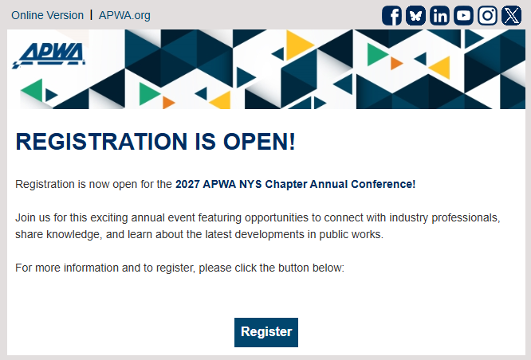

Slide 18
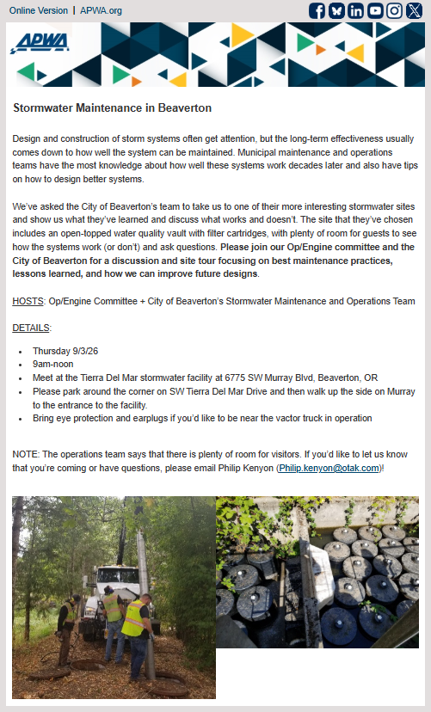
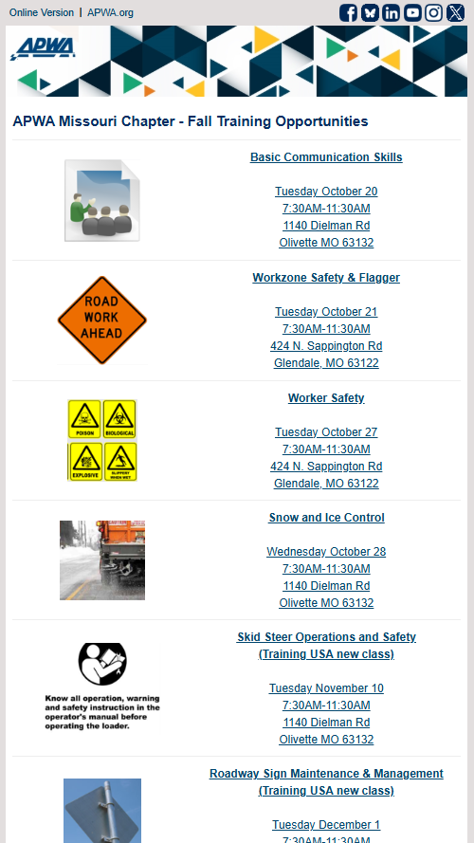

Slide 19
Segment by relevance, not convenience
Different audiences need different reasons to act
SECTION 4
EMAIL MARKETING
Members
Prospects
Attendees
Partners
Continue the value
Deepen participation
Invite a colleague
Explain chapter value
Lower the barrier
Offer a first step
Build on interest
Offer the next event
Invite membership
Show shared benefit
Provide visibility
Clarify support
COMMUNICATIONS 101
Notes:
If advanced segmentation is not possible, vary the message or opening paragraph for the most important audiences.
[Sources]
- Internal source: 23ChapterLeadersTraining_ChapterCommunications.pptx
[/Sources]

Slide 20
Use a campaign, not a single announcement
Build awareness, value, and urgency over time
SECTION 4
EMAIL MARKETING
1
2
3
4
5
6
SAVE THE DATE
OPEN
FEATURE
PROVE
DEADLINE
FOLLOW UP
Introduce the opportunity
Explain the primary benefit
Highlight speaker or content
Share outcomes or testimonial
Create a reason to act
Thank, recap, and invite next step
Adjust the cadence to the size, cost, and complexity of the opportunity.
COMMUNICATIONS 101
Notes:
The original deck provided a sample event schedule. This version emphasizes the purpose of each touch rather than fixed timing.
[Sources]
- Internal source: 23ChapterLeadersTraining_ChapterCommunications.pptx
[/Sources]

Slide 21
Measure the action, not only attention
Use email results to improve the next decision
SECTION 4
EMAIL MARKETING
Attention
Interest
Action
Opens can indicate subject-line or sender recognition. Treat them as directional, not the final outcome.
Clicks show which topics, messages or calls to action earned additional attention.
Registrations, renewals, volunteer signups, and other responses to your calls to action reveal whether the campaign accomplished its goal.
COMMUNICATIONS 101
Notes:
Metrics should lead to a decision: repeat a message, change a subject line, simplify the call to action or adjust the audience.
[Sources]
- Internal source: 23ChapterLeadersTraining_ChapterCommunications.pptx
[/Sources]

Slide 22
Social media makes the chapter experience visible
Use social content to reach, show, and connect.
SECTION 5
SOCIAL MEDIA
Reach
Show
Connect
Introduce chapter opportunities to people beyond the current email list.
Use photos, short videos, and participant stories to make chapter value tangible.
Recognize members, invite conversation, and encourage people to share.
COMMUNICATIONS 101
Notes:
Position social media as one part of the campaign. Complete details and registration should lead back to the website.
[Sources]
- Internal source: 23ChapterLeadersTraining_ChapterCommunications.pptx
[/Sources]

Slide 23
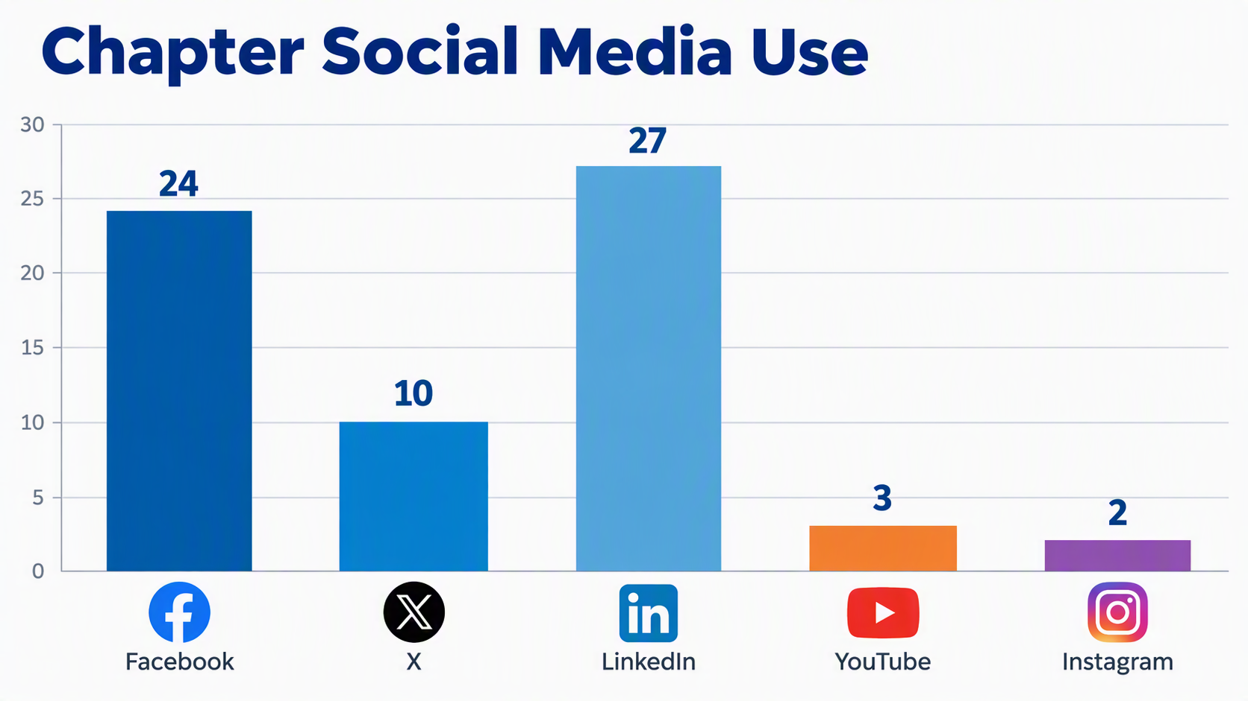

Slide 24
Use five repeatable content buckets
A balanced mix makes planning faster
SECTION 5
SOCIAL MEDIA
01
02
03
04
05
EVENTS
PEOPLE
PROJECTS
LEARNING
IMPACT
Share resources such as documents or recording links
Promote and recap
Spotlight members
Show public works in action
Celebrate results
COMMUNICATIONS 101
Notes:
Use these buckets as recurring categories in the monthly calendar. They reduce the pressure to constantly invent new topics.
[Sources]
- Internal source: 23ChapterLeadersTraining_ChapterCommunications.pptx
[/Sources]

Slide 25
Build a sustainable social calendar
Choose a rhythm your chapter can maintain
SECTION 5
SOCIAL MEDIA
MONDAY
WEDNESDAY
FRIDAY
LEARN
CONNECT
ACT
Resource or industry insight
Member, volunteer, or speaker
Event, deadline, or opportunity
Example cadence only. Quality and consistency matter more than volume.
COMMUNICATIONS 101
Notes:
This example is a suggested starting point, not a universal posting rule. Adjust by audience capacity and chapter resources.
[Sources]
- Internal source: 23ChapterLeadersTraining_ChapterCommunications.pptx
[/Sources]

Slide 26
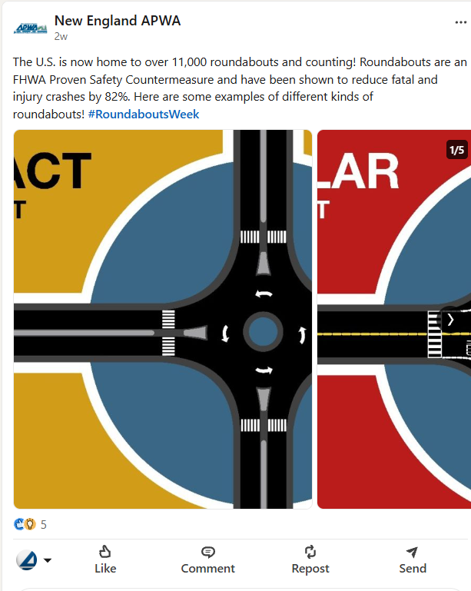
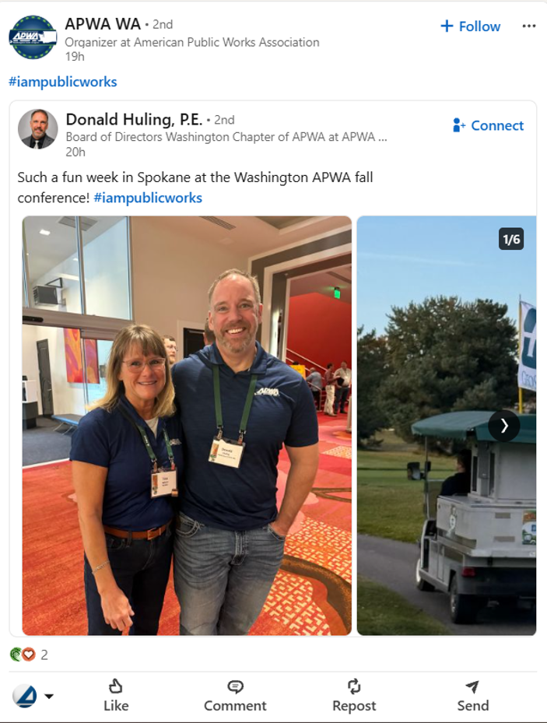

Slide 27
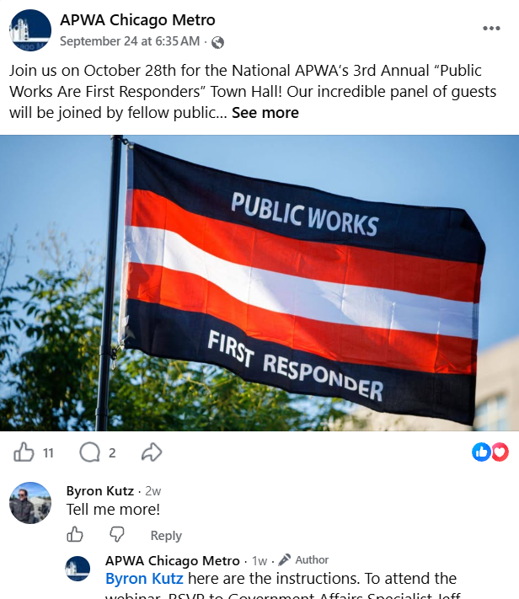
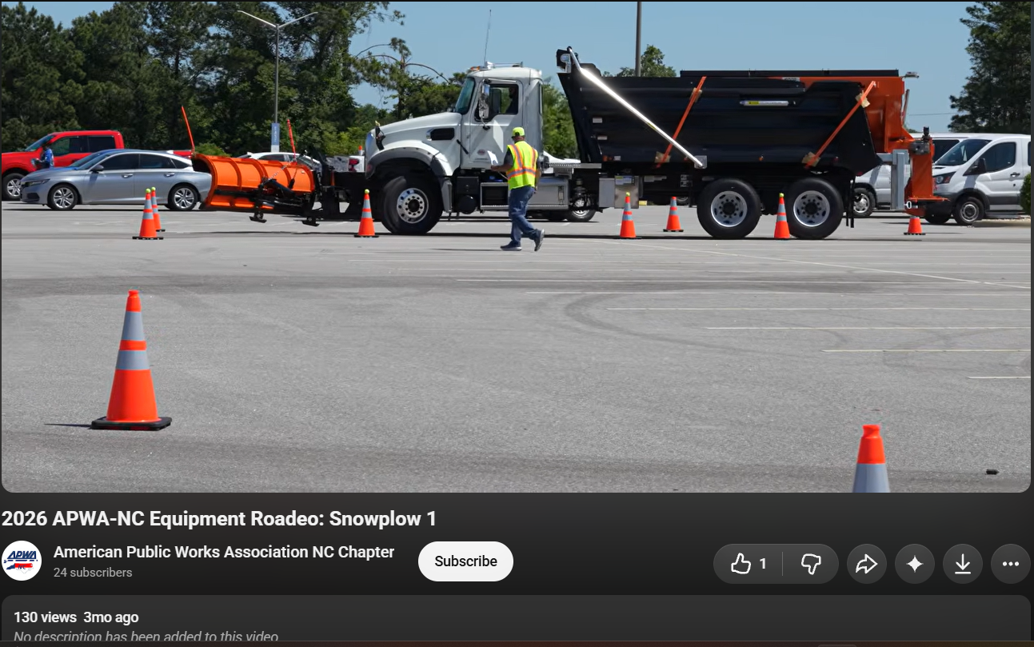

Slide 28
Promote before, during, and after
Extend the value of every chapter event
SECTION 5
SOCIAL MEDIA
Before
During
After
Explain the benefit
Introduce speakers
Answer common questions
Build reminders
Share key moments
Recognize partners
Capture photos and quotes
Invite conversation
Thank participants
Share highlights
Point to resources
Invite the next action
COMMUNICATIONS 101
Notes:
Plan post-event content before the event so someone is responsible for photographs, quotes and follow-up.
[Sources]
- Internal source: 23ChapterLeadersTraining_ChapterCommunications.pptx
[/Sources]

Slide 29
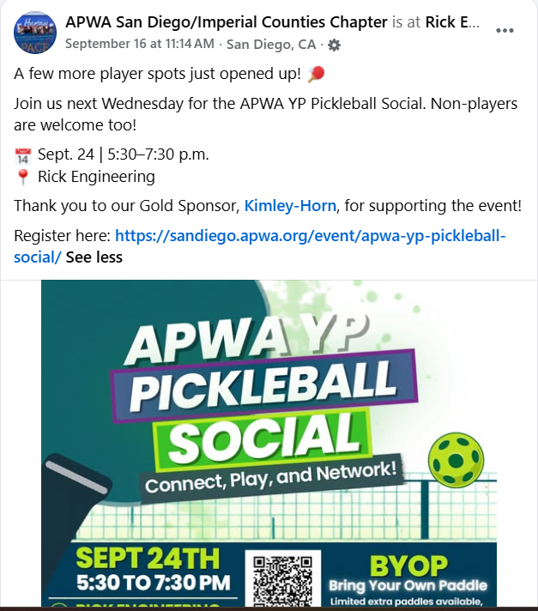
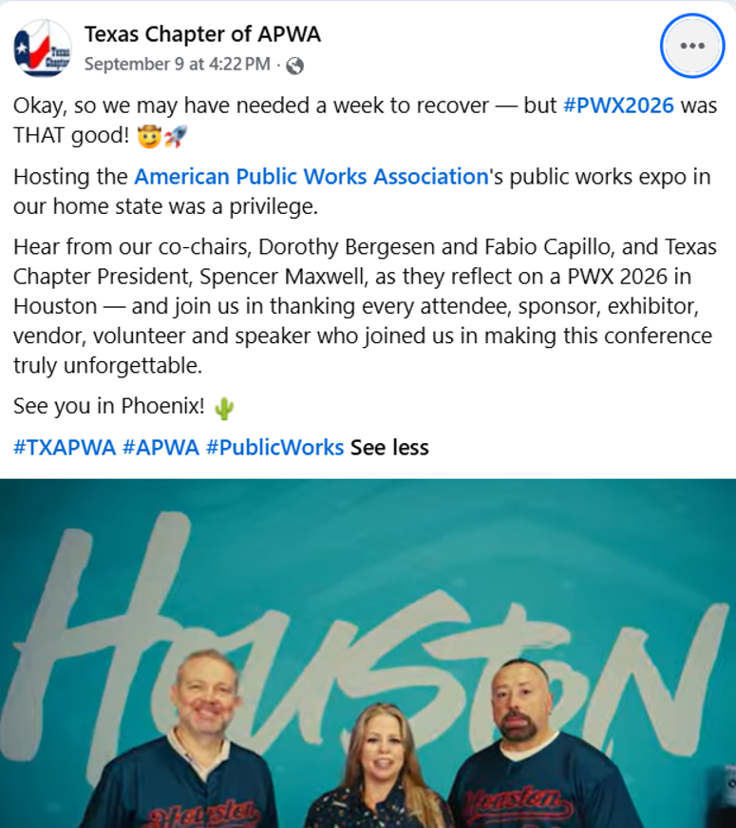

Slide 30
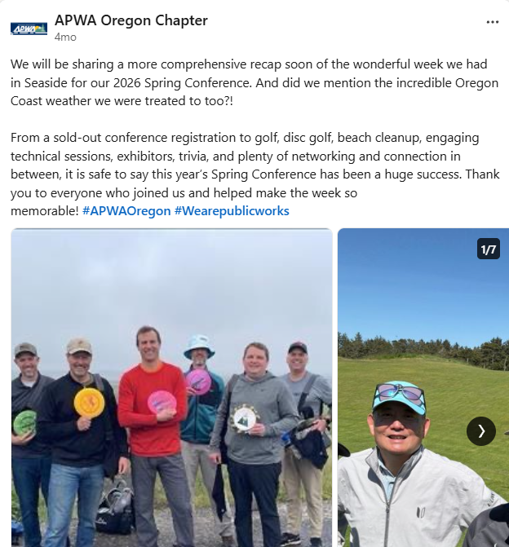
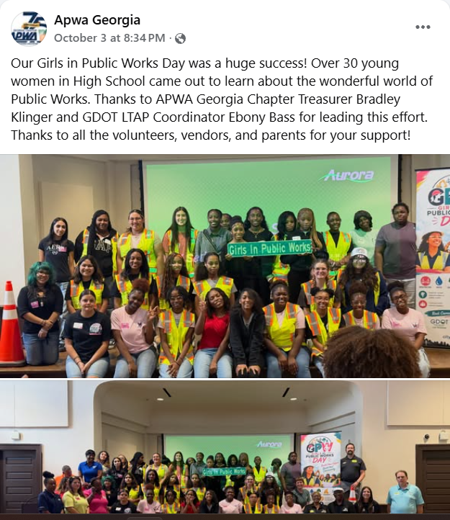

Slide 31
Consistency builds recognition
Make every chapter message feel connected to APWA
SECTION 5
SOCIAL MEDIA
Use current APWA and chapter brand assets.
Keep colors, typography, and visual style consistent.
Write in a professional, accessible chapter voice.
Use clear image permissions and credits.
Use campaign hashtags selectively and consistently.
BRAND CHECK
Would someone recognize this as an APWA chapter message before seeing the logo?
COMMUNICATIONS 101
Notes:
Replace event-year-specific hashtags in the old deck with current campaign guidance when the webinar is delivered.
[Sources]
- Internal source: 23ChapterLeadersTraining_ChapterCommunications.pptx
[/Sources]

Slide 32
Start every campaign with three decisions
Clarity at the beginning saves time throughout the campaign
SECTION 6
BUILD A CAMPAIGN
1
WHO?
2
WHY?
3
WHAT NEXT?
Define the priority audience and the need, barrier, or motivation that matters most.
State the benefit in audience language. Explain the value before the logistics.
Choose one primary action and remove unnecessary steps between interest and completion.
COMMUNICATIONS 101
Notes:
Before choosing a tool or writing copy, the chapter should agree on audience, value and action.
[Sources]
- Internal source: 23ChapterLeadersTraining_ChapterCommunications.pptx
[/Sources]

Slide 33
Example: membership recruitment campaign
A coordinated plan for prospective and less-engaged members
SECTION 6
BUILD A CAMPAIGN
AUDIENCE
MESSAGE
CHANNEL PLAN
SUCCESS
Prospective members
Event attendees
Emerging professionals
Build your network.
Advance your career.
Connect locally.
Website: value + join
Email: targeted invite
Social: member stories
Inquiries
Join-page visits
New members
COMMUNICATIONS 101
Notes:
This is a suggested planning example. Participants should replace the audience and messages with their chapter’s current priorities.
[Sources]
- Internal source: 23ChapterLeadersTraining_ChapterCommunications.pptx
[/Sources]

Slide 34
Example: chapter event campaign
Move audiences from awareness to registration to return attendance
SECTION 6
BUILD A CAMPAIGN
AWARE
CONSIDER
REGISTER
EXPERIENCE
RETURN
›
›
›
›
Show the problem or opportunity
Explain outcomes and address barriers
Make the action direct and urgent
Welcome and deliver value
Follow up with the next opportunity
The campaign continues after registration. The experience and follow-up influence future participation.
COMMUNICATIONS 101
Notes:
Use this funnel to map communication before, during and after the event.
[Sources]
- Internal source: 23ChapterLeadersTraining_ChapterCommunications.pptx
[/Sources]

Slide 35
Campaign planning worksheet
Use this framework for an event or membership campaign
SECTION 6
BUILD A CAMPAIGN
GOAL
What measurable outcome do we want?
AUDIENCE
Who is the priority?
INSIGHT
What matters or creates a barrier?
MESSAGE
What is the clearest benefit?
CHANNELS
What job will each channel perform?
CTA
What should the audience do next?
OWNER
Who creates, approves, and publishes?
MEASURE
How will we know it worked?
COMMUNICATIONS 101
Notes:
Use the worksheet as the central webinar activity. Teams can draft a campaign in 10 to 15 minutes.
[Sources]
- Internal source: 23ChapterLeadersTraining_ChapterCommunications.pptx
[/Sources]

Slide 36
Evaluate tools by the job to be done
A free tool is not helpful if it adds complexity
SECTION 7
TOOLS THAT SAVE TIME
Create
Manage
Measure
Graphics
Short video
Templates
Photo editing
Editorial calendar
Approvals
Asset storage
Task ownership
Email response
Website activity
Social performance
Campaign outcomes
COMMUNICATIONS 101
Notes:
Begin with the workflow problem. Then compare tools. Avoid collecting disconnected platforms that volunteers must learn and maintain.
[Sources]
- Internal source: 23ChapterLeadersTraining_ChapterCommunications.pptx
[/Sources]

Slide 37
Create quality content on a budget
Use tools that are no- or low-cost
SECTION 7
TOOLS THAT SAVE TIME
Canva
Adobe Express
Templates and social graphics
Graphics and short-form content
APWA assets (brand guide, chapter logo)
Stock libraries (Pixabay, Pexels, Unsplash, Canva)
Approved logos and campaign materials
Supporting photography and visuals
Confirm current pricing, licensing, and chapter access before adopting a platform.
COMMUNICATIONS 101
Notes:
The named tools appeared in the original deck or are included as suggested categories. Pricing and availability can change, so chapters should verify current terms.
[Sources]
- Internal source: 23ChapterLeadersTraining_ChapterCommunications.pptx
[/Sources]

Slide 38
Create quality content on a budget continued
SECTION 7
TOOLS THAT SAVE TIME
AnswerStage or Gather Voices
Monday, Asana, Appflowy, and others
Video testimonials
Social media content calendar
LinkedIn Page Analytics, Meta Business Suite, Instagram Insights
Google Analytics 4
Native platform analytics
Website analytics
COMMUNICATIONS 101
Notes:
The named tools appeared in the original deck or are included as suggested categories. Pricing and availability can change, so chapters should verify current terms.
[Sources]
- Internal source: 23ChapterLeadersTraining_ChapterCommunications.pptx
[/Sources]

Slide 39
Choose tools that reduce coordination work
Organization is often the biggest time-saver
SECTION 7
TOOLS THAT SAVE TIME
A shared content calendar everyone can access.
A simple approval path with one accountable owner.
Reusable templates for recurring messages.
A central location for approved images and logos.
A scheduler only if it fits the chapter’s workflow.
KEEP IT SIMPLE
Calendar
+
Templates
+
Clear ownership
COMMUNICATIONS 101
Notes:
A spreadsheet, shared folder and clear owner may be more sustainable than a feature-rich platform.
[Sources]
- Internal source: 23ChapterLeadersTraining_ChapterCommunications.pptx
[/Sources]

Slide 40
Measure what supports the chapter goal
Build a simple dashboard, not a data warehouse
SECTION 7
TOOLS THAT SAVE TIME
WEBSITE
EMAIL
SOCIAL
OUTCOMES
Visits to priority pages
Registration clicks
Opens
Clicks
Conversions
Likes and Shares
Referral traffic
Meaningful responses
Registrations
Members
Volunteers
COMMUNICATIONS 101
Notes:
Choose measures before launching the campaign. Use the results to decide what to repeat, change or stop.
[Sources]
- Internal source: 23ChapterLeadersTraining_ChapterCommunications.pptx
[/Sources]

Slide 41
Chapter communications self-assessment
Identify the next improvement, not every improvement
SECTION 8
ACTION PLANNING
We have a shared communications calendar.
YES
SOMEWHAT
NOT YET
Our website, email, and social media work together.
YES
SOMEWHAT
NOT YET
We know which audience each campaign prioritizes.
YES
SOMEWHAT
NOT YET
Our messages lead with value and a clear action.
YES
SOMEWHAT
NOT YET
We review results and adjust future communications.
YES
SOMEWHAT
NOT YET
COMMUNICATIONS 101
Notes:
Ask participants to identify one “not yet” item that would create the greatest improvement in the next 90 days.
[Sources]
- Internal source: 23ChapterLeadersTraining_ChapterCommunications.pptx
[/Sources]

Slide 42
Build your 90-day action plan
Choose focused actions that can be completed with current resources
SECTION 8
ACTION PLANNING
1
2
3
4
5
WEBSITE
EMAIL
SOCIAL
CAMPAIGN
MEASURE
One improvement
One improvement
One improvement
One launch
One result
COMMUNICATIONS 101
Notes:
Have participants write a named owner and target date for each selected action after the webinar.
[Sources]
- Internal source: 23ChapterLeadersTraining_ChapterCommunications.pptx
[/Sources]

Slide 43
Take-home resources
Turn the webinar into a repeatable chapter process
SECTION 8
ACTION PLANNING
✓
Annual communications calendar
✓
Monthly content planner
✓
Campaign planning worksheet
✓
Website checklist
✓
Email checklist
✓
Tool evaluation scorecard
✓
Simple measurement dashboard
✓
90-day action plan
COMMUNICATIONS 101
Notes:
Package these resources with the webinar so participants can apply the framework immediately.
[Sources]
- Internal source: 23ChapterLeadersTraining_ChapterCommunications.pptx
[/Sources]

Slide 44
Choose one audience. Solve one need.
Make one action easy, then measure what happens next.
SECTION 8
ACTION PLANNING
PLAN → COORDINATE → ACT → LEARN
What is one change you will make in your chapter communications?
Questions + discussion
COMMUNICATIONS 101
Notes:
Close by asking participants to name one action. Reinforce that a small, repeatable system is more valuable than an ambitious plan that cannot be sustained.
[Sources]
- Internal source: 23ChapterLeadersTraining_ChapterCommunications.pptx
[/Sources]

