Slide 1
Fonteva Event Building & WordPress —
How It’s Connected
September 14, 2026
12 Noon Central

Slide 2
What’s New?

Slide 3
One Stop for Events
Previously, chapter leaders were required to create an event in Fonteva and then separately log into WordPress to recreate the event on their chapter website.
Today, Fonteva serves as the single point of entry for chapter events. Once an event is created in Fonteva, it automatically syncs to WordPress and populates both the chapter website and APWA events calendar. This enhancement streamlines event management, reduces duplicate work, and improves consistency across platforms.

Slide 4
Media Collections
Initially, chapters did not have the ability to upload or update event images directly within Fonteva. After hearing feedback from chapters, APWA worked to add the Media Collections module to the Chapter Leader Portal.
This enhancement now allows chapters to upload and manage images directly within their events, improving the visual presentation of chapter events on websites and event pages.

Slide 5
Contact Search Result Enhancements
Chapter Services continually received feedback from chapter leaders who were registering others for events and had difficulty determining whether they were selecting the correct contact record.
For example, registrants might see multiple “John Smith” records with no additional identifying information. To address this, APWA enhanced the contact search results to include additional details such as city and state, helping users more confidently select the correct registrant and reducing registration errors.

Slide 6
NEW EVENT BUILDER HOW TO GUIDE
Located in Chapter Leader Resources
  Events & Meetings
    Fonteva Event Builder Walkthrough – Revised May 2026

Slide 7
We want to hear from you!
APWA continues to make incremental enhancements to improve the chapter leader experience based directly on chapter feedback.
chapterservices@apwa.org

Slide 8
Fonteva and Word Press – Interconnected
Fonteva is now the one source of truth for events that are built using Fonteva.
You will no longer edit events via Word Press; you will edit the event in Fonteva.

Slide 9
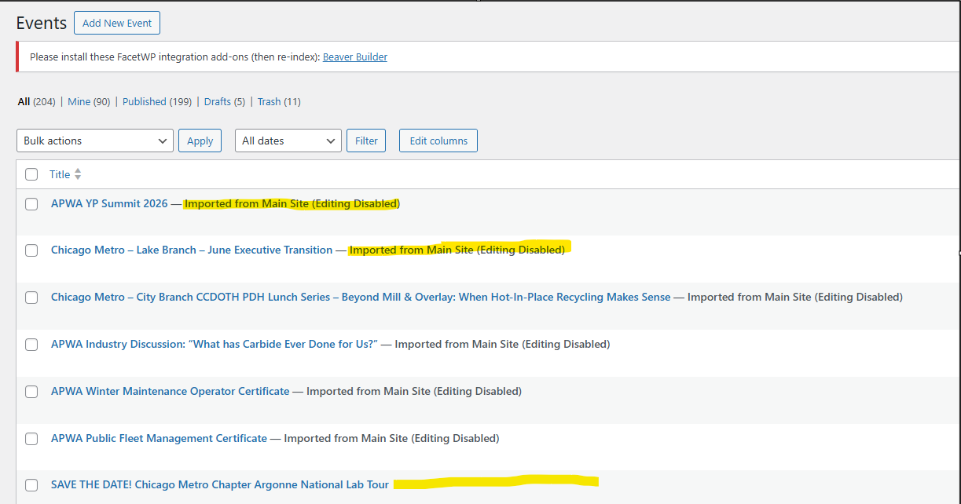
Events – Word Press

Slide 10
Questions?
Contact by email at chapterservices@apwa.org
Please provide as much information as possible.
If you would like a 1-1 training session, please email chapterservices@apwa.org
If you need assistance and would like chapter services to build your event click here to access event template and email to chapterservices@apwa.org

